Slide 1
Sinopia Module 10
Cataloging Workflow

Slide 2
Scope of this module
Module 9: Cataloging Workflow covers:
Step-by-step procedure for cataloging a sample monograph (book)
Step-by-step procedure for cataloging a new instance of an existing work (ebook)
Step-by-step procedure for cataloging a sample monograph (book) with non-Roman script

Slide 3
Workflows: Where to start
Full Sinopia descriptions include both an Instance and a Work (items are optional and depend on your individual ILS environment). Because they are separate, you have the option to start either with a an Instance description or with a Work description.
Why start with an Instance template? | Why start with a Work template?
You may want to start with an Instance template if you want your data entry experience to be similar to MARC record creation, entering transcribed strings and physical data from the item in hand before analyzing the nature of the work. Starting with an instance template also has some further benefits which may or may not be useful to you. This will be pointed out further on in the module | You may want to start with a Work template since it corresponds to the top level in the BIBFRAME model. Starting with a Work template lets you enter data that applies to all Instances of a Work, and then go on to enter specific Instance data afterwards.

Slide 4
Workflow Overview starting with an Instance
Each step is explained in detail in the following slides. See previous modules if you need to review how to find and open a PCC Template and how to enter data in fields.
Step 1: Create Instance description
Step 2: Create Work description
Step 3: Link from Instance to Work
Note: This basic workflow does not include linking to other instances/manifestations.

Slide 5
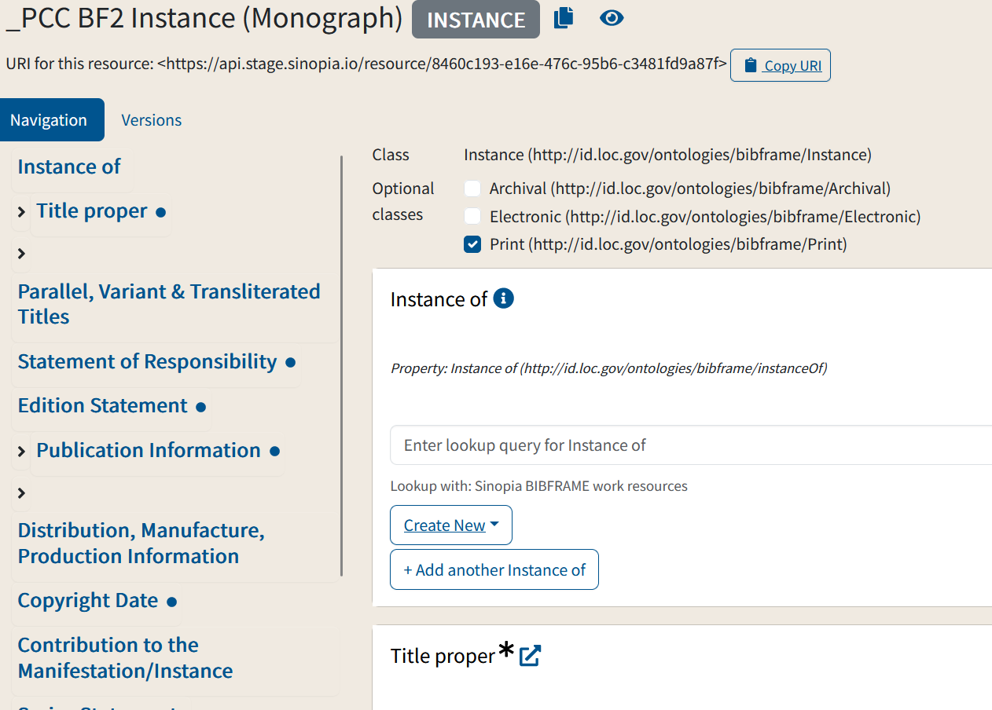
Step 1: Create Instance
Step 1: Create Instance
Open Instance template.
Enter metadata into the fields using Original RDA guidelines
Save.
(You can’t fill in the Instance of field yet since you haven’t yet created your Work yet, but save anyway--this is where you will link the instance to the work.)
Don't close the template!
Remember:
Don't forget to choose the type of instance.
Not all fields are mandatory!
The "i" icon (when present) can help you understand what data to enter & how to enter it

Slide 6
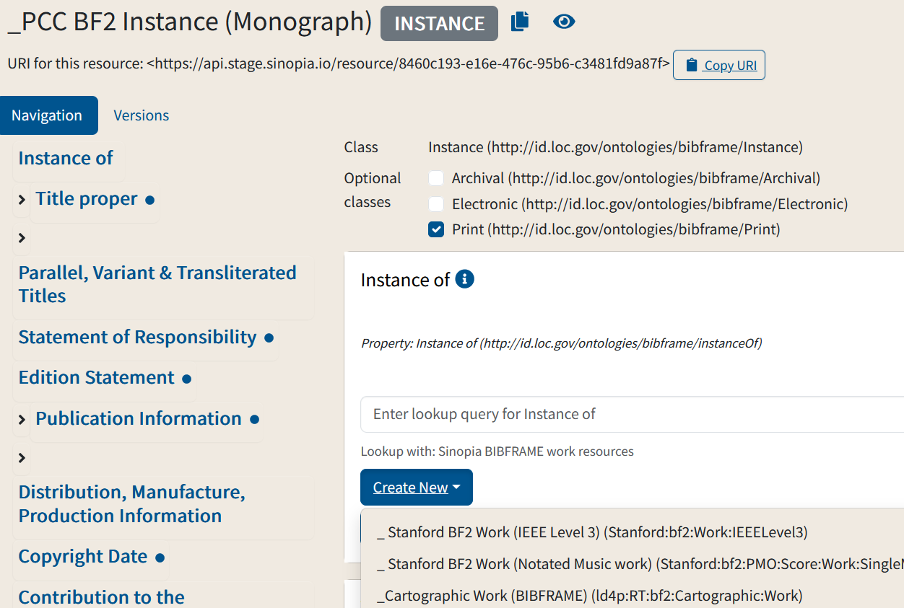
Step 2: Create Work
Step 2, Part 1: Create Work
From the Instance template, "Instance of" field, select "Create New".
From the dropdown menu choose:
_PCC BF2 Work (Monograph) (pcc:bf2:Monograph:Work)
Make sure both the template name & id match (some institutions may have incorrectly duplicated the template name)

Slide 7
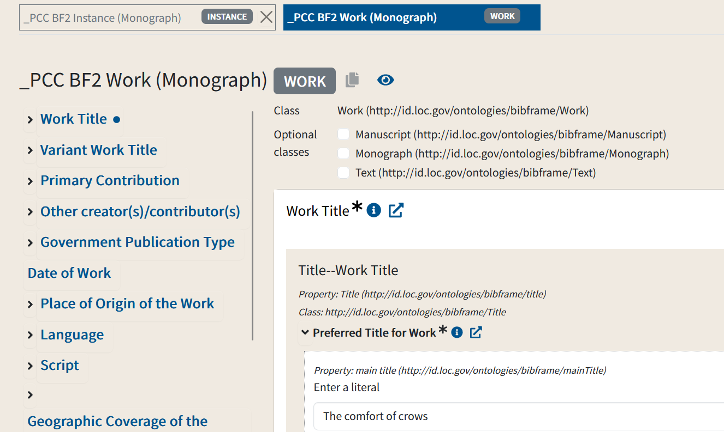
Step 2: Create Work
Step 2, Part 2: Create Work
A work template will open in a new tab
The work title is auto-filled by the title of the Instance
Enter metadata into the fields following Original RDA guidelines
Save.
Note: You may need to adjust the work title to conform to PCC rules for work titles. In the example here, you will need to remove the initial article "The" and capitalize "comfort".
Change to "Comfort of crows"

Slide 8
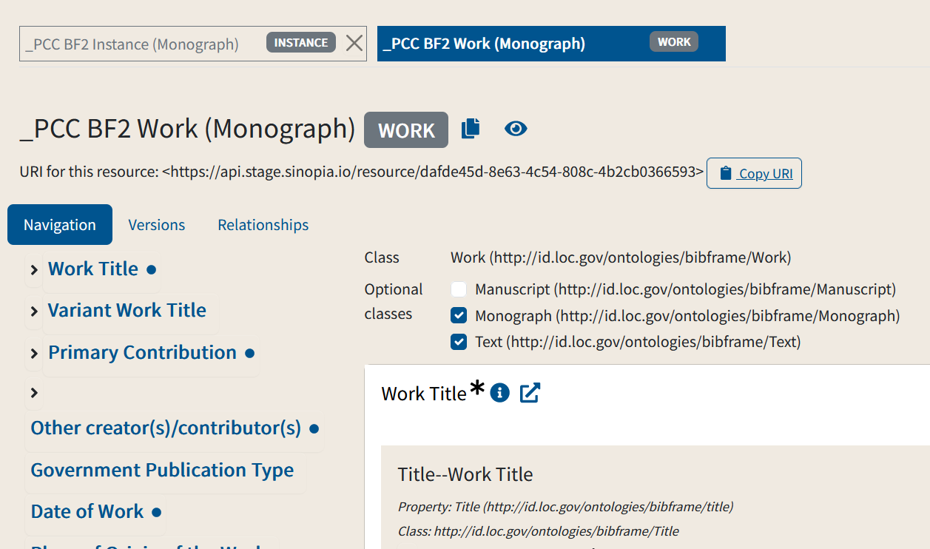
Step 3: Link Instance & Work
2
Step 3, part 1: Link Instance & Work
Copy the URI for the work by clicking on "Copy URI"
Click on the tab for instance the instance
1
Note: You can tell these are descriptions because of the "instance" & "work" tags on the tab headers

Slide 9
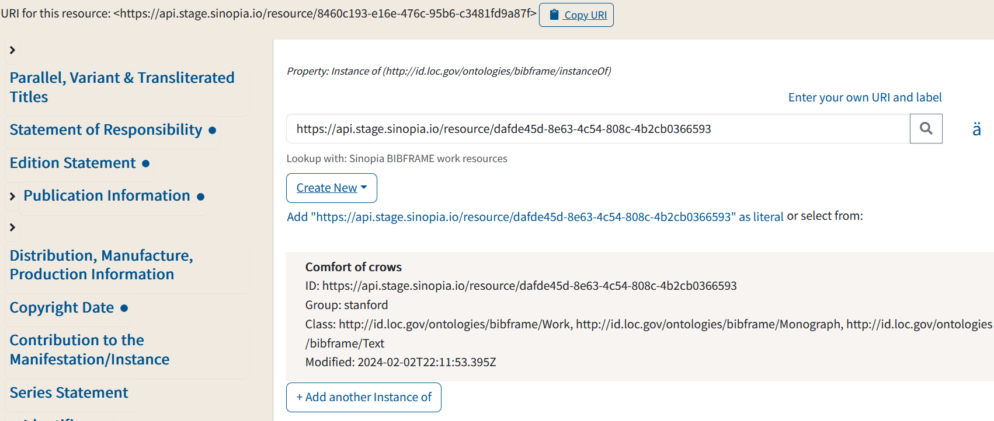
Step 3: Link Instance & Work
Step 3, part 2: Link Instance & Work
After clicking on the instance tab, your instance will appear on the screen
Paste the URI you copied into the lookup in "Instance of"
Click on the magnifying glass or hit enter to do the lookup
The work title will appear as the only result

Slide 10
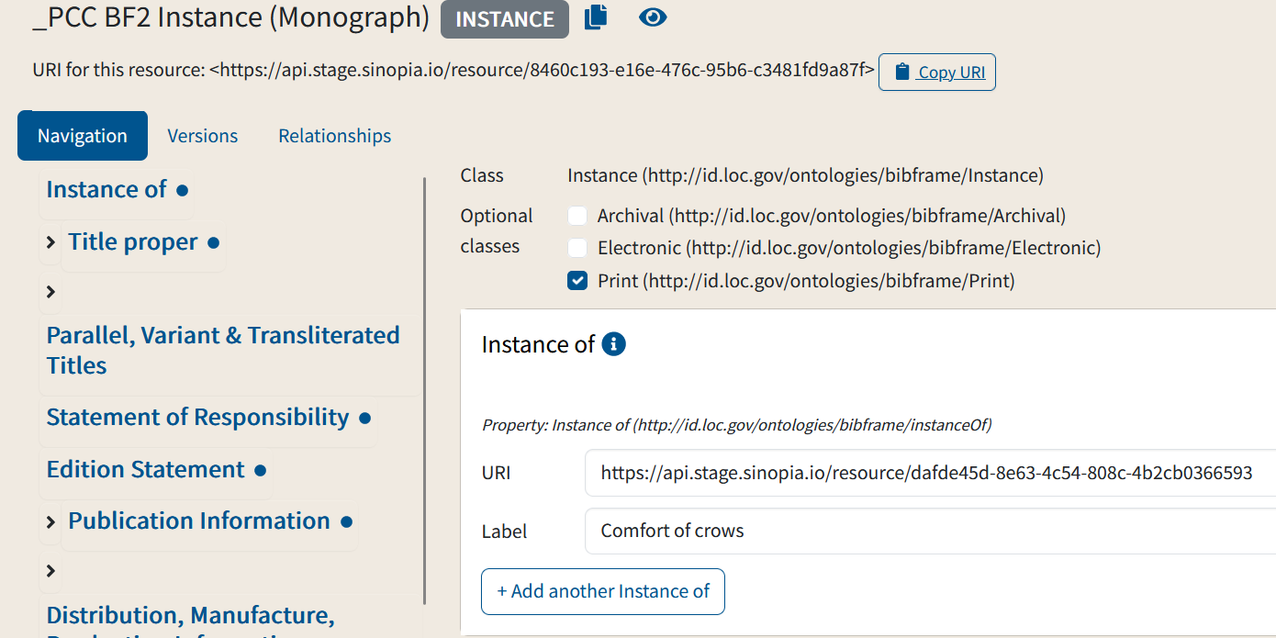
Step 3: Link Instance & Work
Step 3, part 3: Link Instance & Work
Click on the search result; the URI & label will be entered in the "Instance of" field
Save!
Your catalog description is complete!

Slide 11
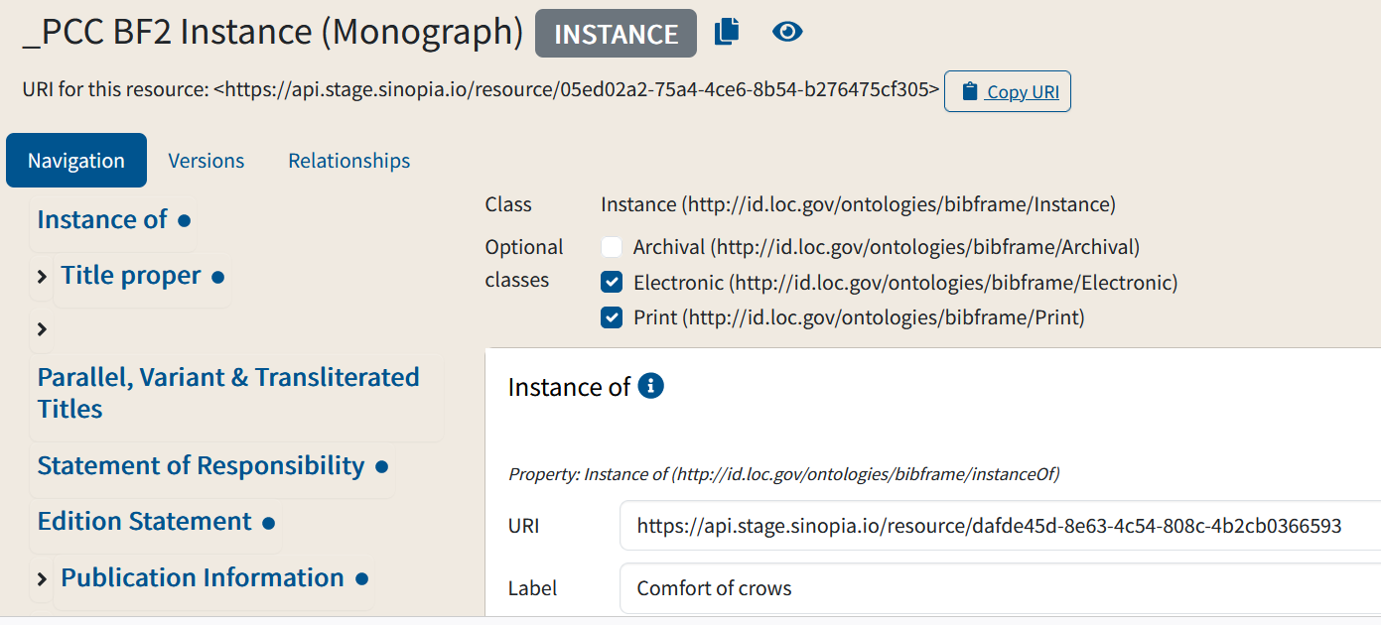
Bonus: A 2nd instance of the work
In your cataloging, you may come across a different instance of the same work. For example, you may have both the print & electronic versions of the same work.
In these cases, you can click on the "duplicate" button to create a new instance from the original, fill in any extra or changed data you require and save.
The new instance will already be linked to the original work so you don't need to do that step!

Slide 12
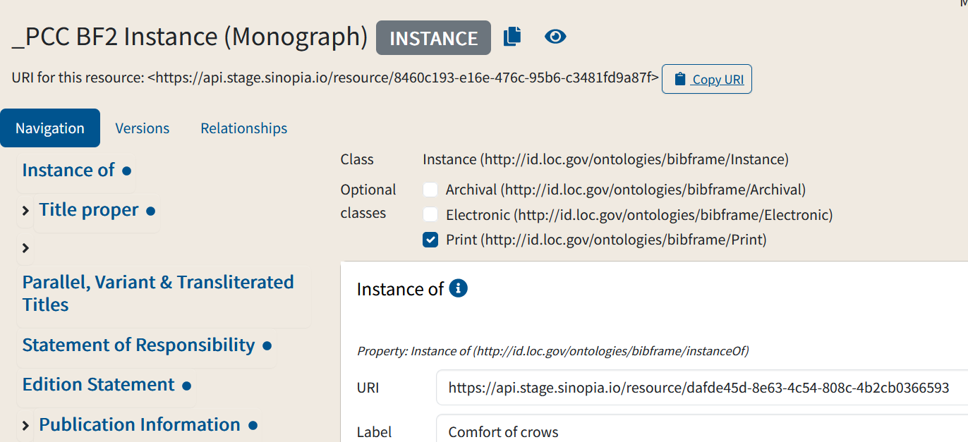
Bonus: A 2nd instance of the work
In your cataloging, you may come across a different instance of the same work. For example, you may have both the print & electronic versions of the same work.
In these cases:
in your instance description, click on the "copy" button
A duplicate of the instance (without the instance URI), will appear on your screen

Slide 13
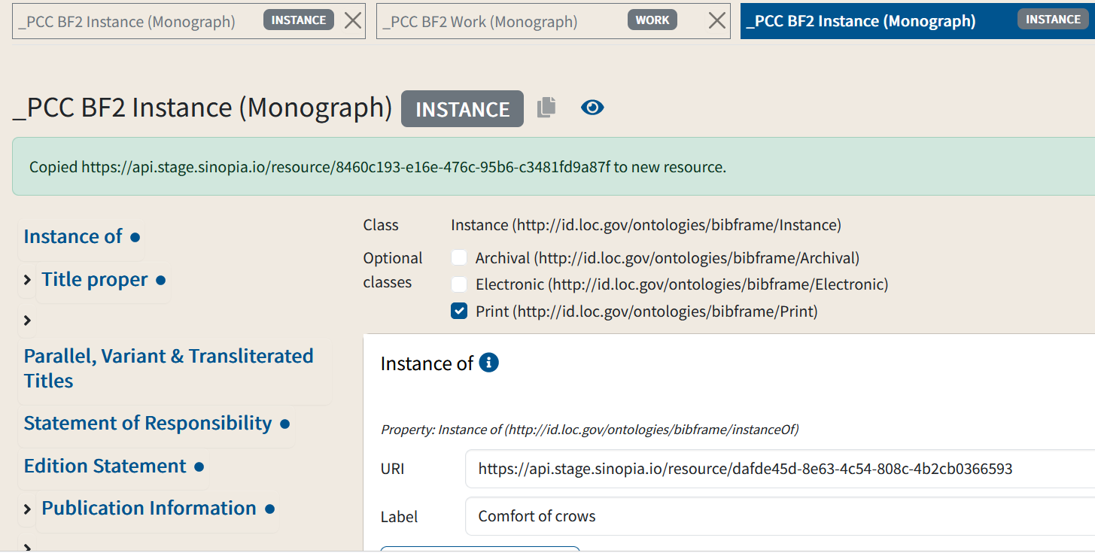
Bonus: A 2nd instance of the work
That it is a duplicate is clear from the green banner you will see. This will disappear after a few moments.
In the duplicated description
add and/or edit any necessary fields (e.g., add the subclass "electronic", digital file type information & URL for resource, new Admin metadata)
Save the description

Slide 14
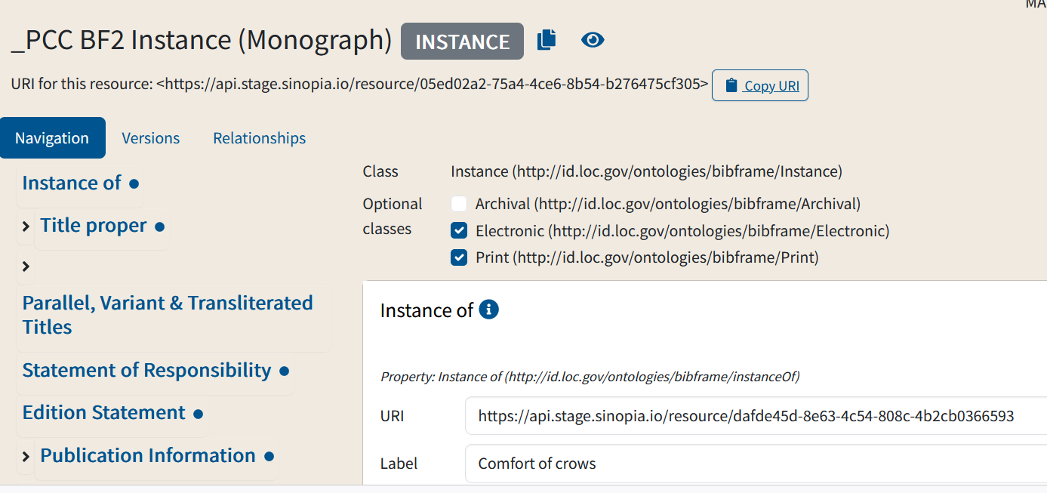
Bonus: A 2nd instance of the work
A new description is created with a new URI to identify it. Note that it is already linked to the work.

Slide 15
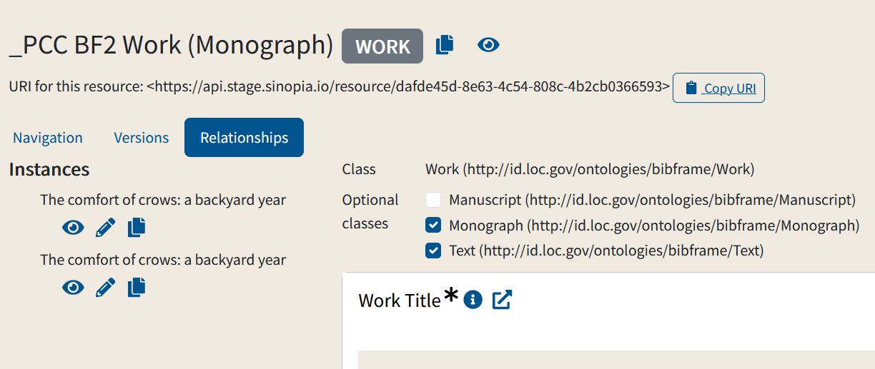
Exploring Links
If you want to see if a work has one or more instances linked to it, click on the "Relationships" button
In this example, you can see that the work now is linked to 2 instances

Slide 16
End of Module 10

