Slide 1

Sinopia Training Module 2
Getting Started in Sinopia

Slide 2
Scope of this module
Module 2: Getting Started in Sinopia covers
What you can do in Sinopia
Sinopia environments & supported browsers
Creating a Sinopia account
Navigating the Sinopia interface
Reporting bugs

Slide 3
What is Sinopia?
Sinopia is a linked data creation environment, developed by Linked Data for Production (LD4P), funded by the Mellon Foundation
Sinopia enables catalogers to:
  catalog in a linked data environment without having to set up & maintain tools locally
  develop best practices related to linked data creation
  explore cooperative cataloging in a linked data environment

Slide 4


Stage vs Production
There are two primary Sinopia environments, Stage and Production:
stage.sinopia.io
sinopia.io
Sinopia users’ test environment intended for practice
Users can create data while in training and not worry about the quality of the data
Descriptions (and templates) may be deleted from time to time
PCC Templates available (see Module 4: About the PCC Templates)
Environment for “production-level” or “permanent” metadata creation
Metadata in this repository will be saved for a minimum of 5 years after the LD4P3 grant ends (2026)
As of publication of this training, the PCC Templates are not yet available

Slide 5
Sinopia Development
Sinopia Development is primarily for use by Sinopia developers & product owners to test updates to Sinopia before going live
It is also currently being used by an Ex Libris Alma test group
Please, only use Sinopia Development if you are part of the Alma group

Slide 6
Supported web browsers
Sinopia is web-based, so you don’t have to install any software
  You may use any browser, but be aware that Sinopia upgrades are tested in Chrome only
  Report any problems with other browsers if you find them

Slide 7
Accounts
You need a Sinopia account to:
  Create descriptions
  Edit descriptions
  Browse, search, and view existing descriptions
You need separate accounts for Stage and Production, so if you want to use both, you need to sign up twice
  You can use the same username, email, and password for both, if you prefer

Slide 8
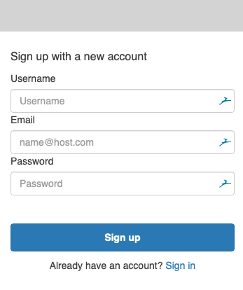
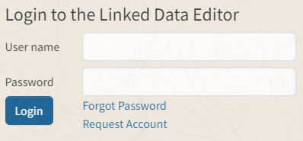
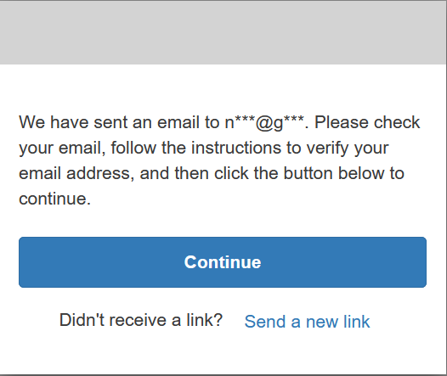
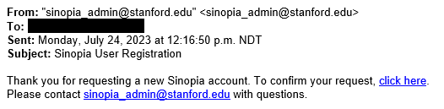
Creating an account
Go to stage.sinopia.io or sinopia.io
Click Request Account
Enter a username, email, and password.
Click the "Continue" button.
You’ll receive an email asking you to confirm.

Slide 9
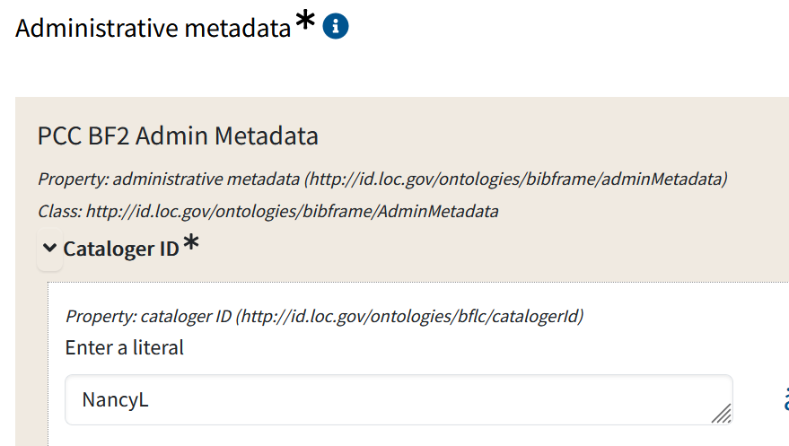
Your Username = Cataloger ID
Your username is not only for your login to Sinopia when you use Sinopia templates; it will autofill in all your descriptions as your Cataloger ID & other users will see it. Please keep that in mind when choosing!

Slide 10
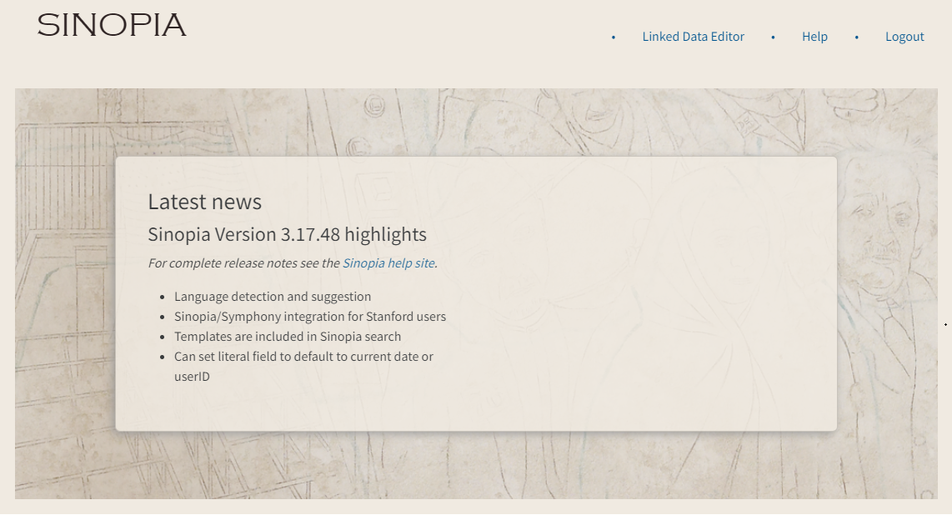
After logging in
Once you create an account and log in, your screen looks like this
Click the Linked Data Editor button to start using Sinopia.

Slide 11
Navigating in Sinopia
After clicking Linked Data Editor, you’ll be on the Dashboard, which has links to your recent templates, searches and resources. Other links are:
Resource Templates Search for and select templates.
See Module 4: About the PCC Templates
Actions dropdown
Load RDF
Exports
View metrics
  Resources
  Templates
  Users
not covered in this training
Search bar
Search for descriptions created in Sinopia.
See Module 3: Searching for Data Created in Sinopia
Help
Sinopia help site
Report a bug
Suggest a new feature
Release Notes
Lookups & QA help

Slide 12
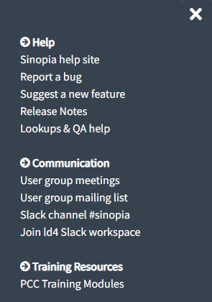
Sinopia Help Site
Your feedback is important! From the Help menu, click Report a bug to report problems, or Suggest a new feature to propose new ideas for Sinopia. Both links open a form in GitHub. You will need to set up a free GitHub account (www.github.com) to fill in the forms.
You can also ask questions, report problems, and suggest ideas on the #sinopia Slack channel in the LD4 Workspace (ld4.slack.com)

Slide 13
Sinopia technical details
This training is based on Sinopia version 3.17.74, released in December 2023, with bug fixes and dependency updates released periodically since then.
If you’d like to know more about the latest release of Sinopia and see detailed notes about each release, visit the Sinopia help site from the Help menu or by going directly to help.sinopia.io, and then click on Latest release
Short videos demonstrating Sinopia features are available on YouTube

Slide 14
End of Module 2

