Slide 1
Sinopia Training Module 3
Searching for Data Created in Sinopia

Slide 2
Scope of this module
Module 3: Searching for Data Created in Sinopia covers
Finding descriptions in Sinopia after they are created using the Search tab
Filtering search results
Using the Dashboard to see recent searches

Slide 3
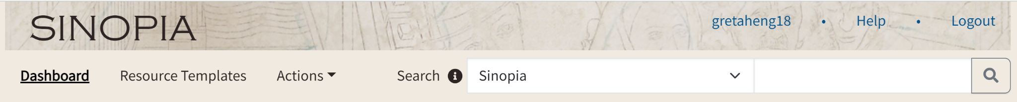
When to Search
Search for data created in Sinopia to
  check whether something has already been cataloged so you can re-use the metadata
  find a description you know is in Sinopia so that you can view, edit, or make a copy of it
  search for related Works or Instances to link to your description

Slide 4

Starting a Search
Verify that the Search drop-down is set to the default Sinopia.
Type your search string in the Enter query string box, and click icon or press Enter on your keyboard.

Slide 5
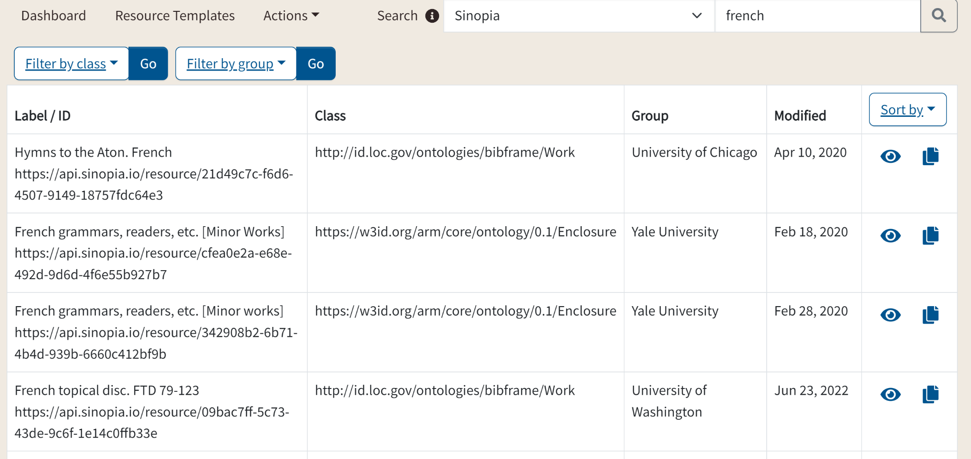
What is being searched?
Search function performs a keyword search of all literal data from any field.
Search is not case sensitive.
Example:
french finds french and French

Slide 6
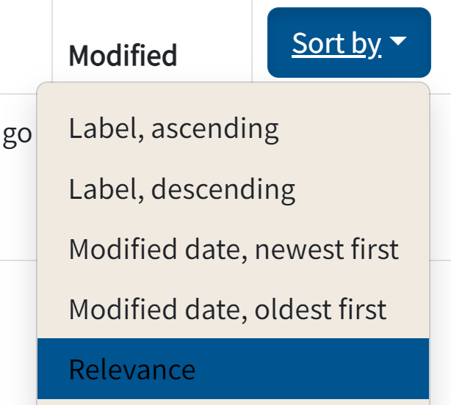
Sorting the results
Results are sorted by relevance by default
  matches found in title fields considered more relevant than other matches
Choose a different sort order using the Sort by drop-down
  Sorting by Label is equivalent to sorting by the title of the work or instance

Slide 7
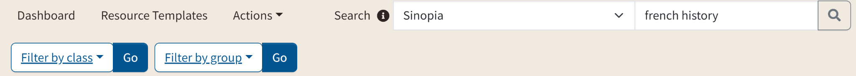
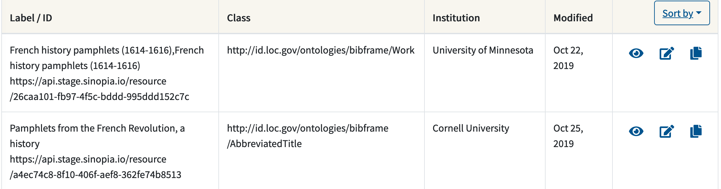
Multi-word searches: AND by default
The default operator for multi-word searches is AND
Example:
french history finds French history pamphlets but not French sculpture census

Slide 8
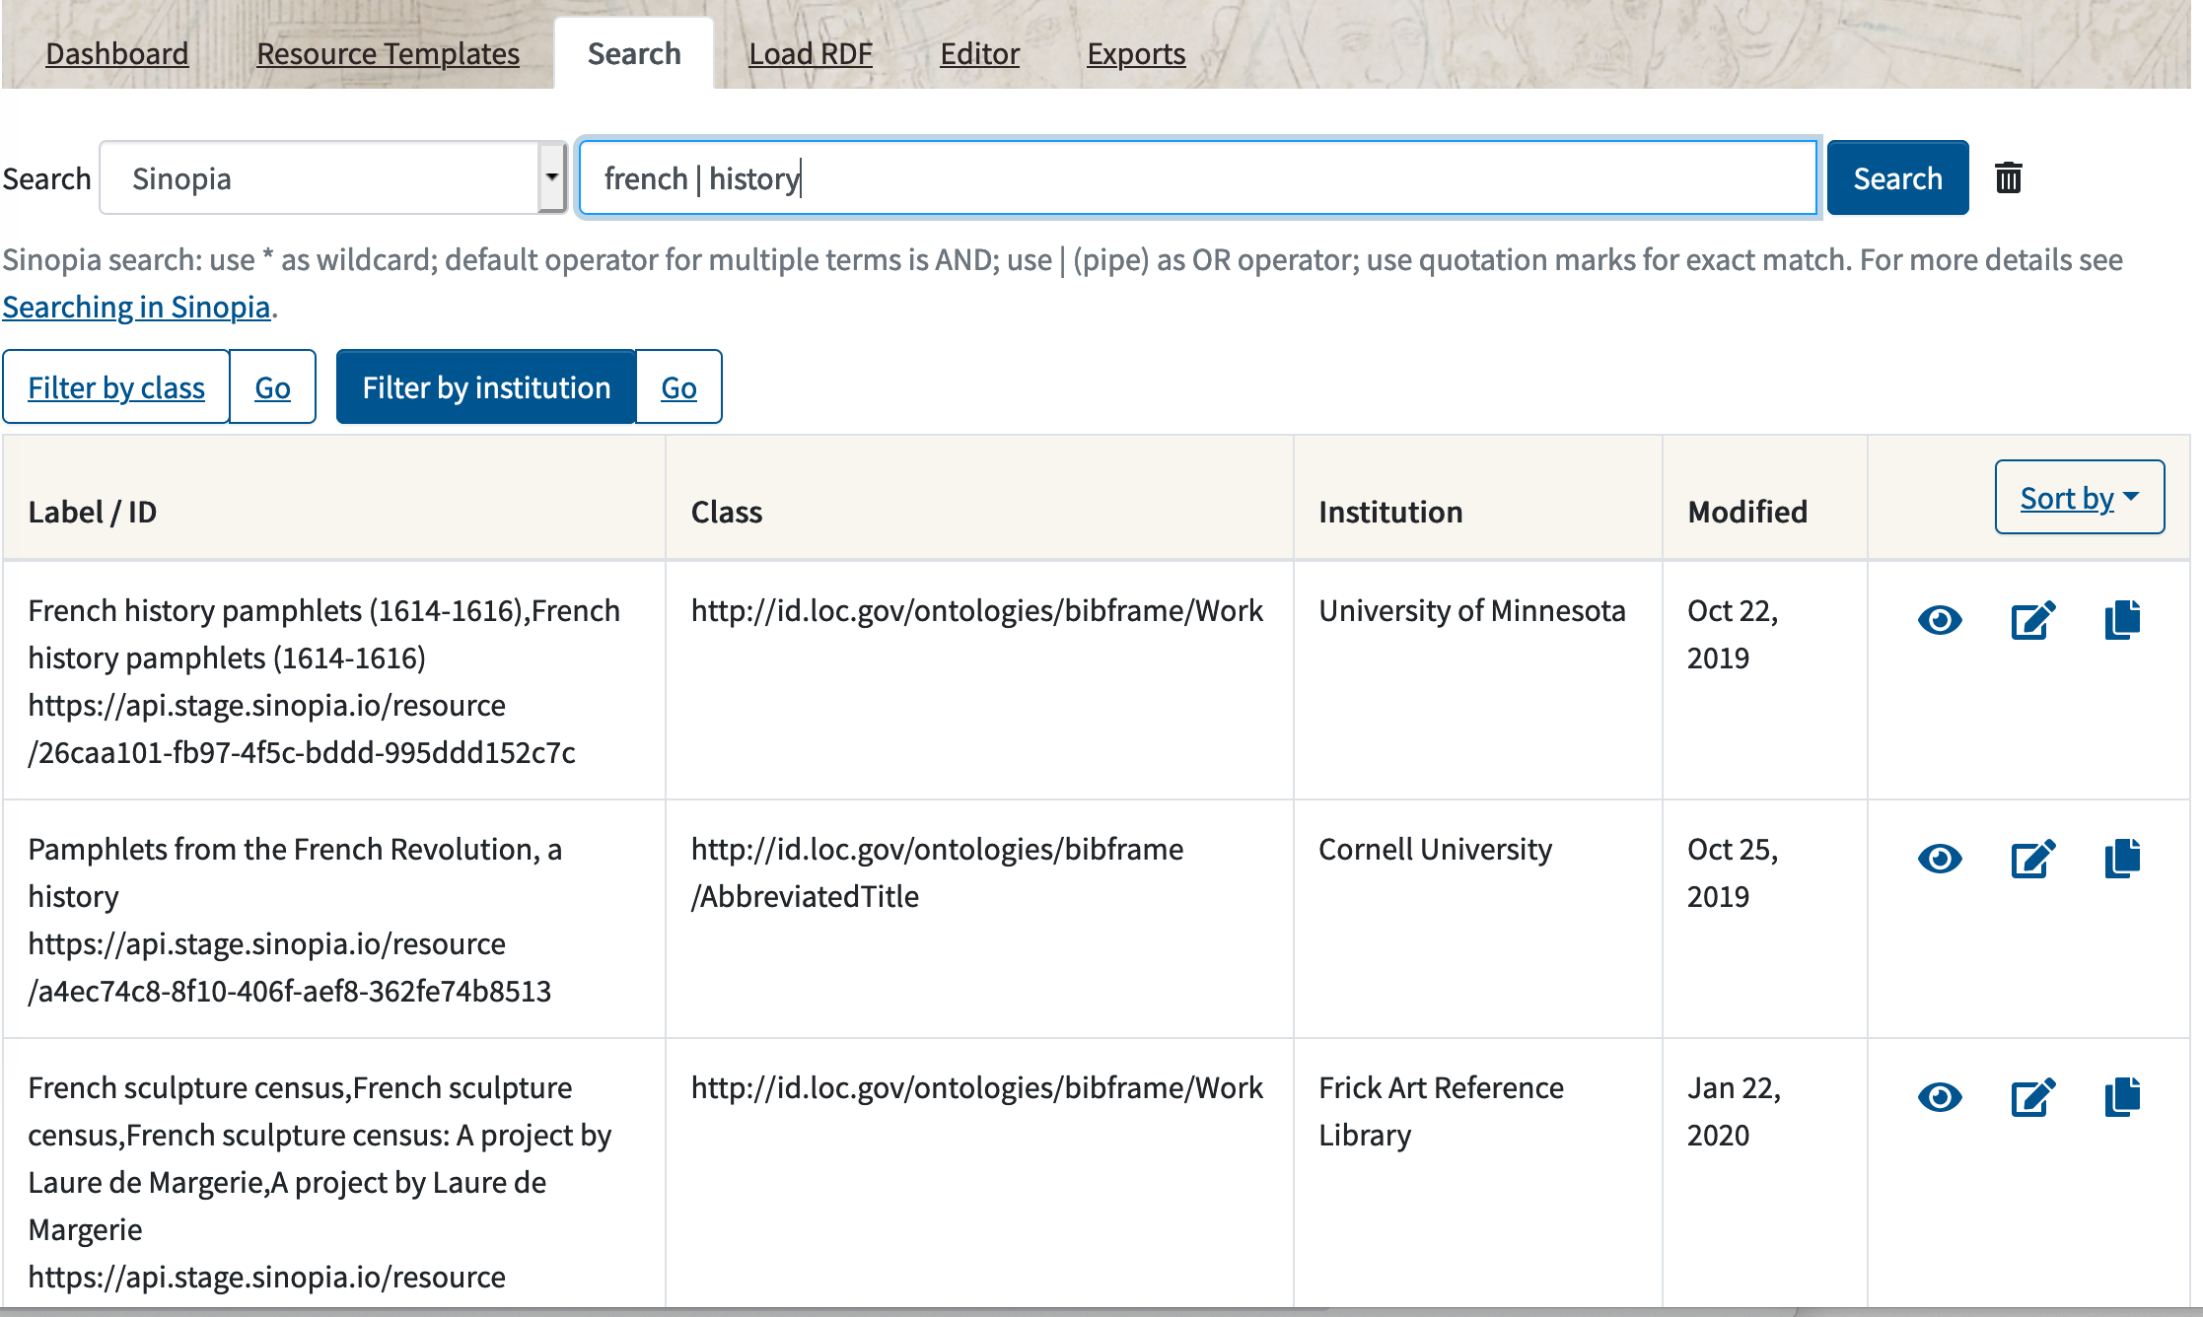
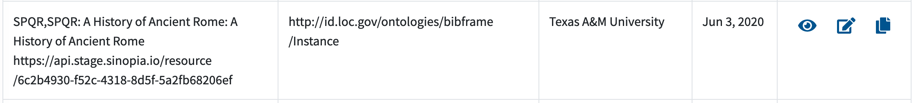
Multi-word searches: Using OR
For OR searches, use the vertical pipe
Example:
french | history finds French history pamphlets and French sculpture census and A history of Rome

Slide 9
Multi-word searches: Phrases
Multi-word searches are not handled as phrase searches; use quotation marks for phrase searches.
Examples:
Search: french history
Result: French history pamphlets and Pamphlets from the
French Revolution, a history
Search: "french history"
Result: French history pamphlets but not Pamphlets from
the French Revolution, a history

Slide 10


Word stemming & Find all
Default search is for whole words.
Use an asterisk * as a wildcard character to truncate/stem a word
  Example: searching for sun does not find sunshine, but searching for sun* finds sun, sunshine, sunflower, etc.
To “find all”, search with just the wildcard character (*).

Slide 11
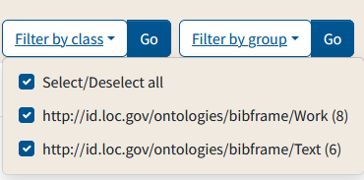
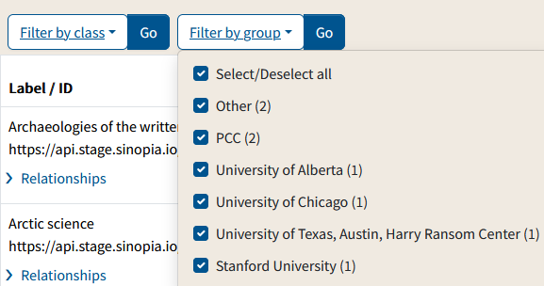
Filtering results
To reduce the number of results, you can filter by the class of the resource, or by the institution or group that created the description.
Click a Filter by button and then uncheck the categories you do not want in your results.
Click Go to filter the results list to the categories you checked.

Slide 12
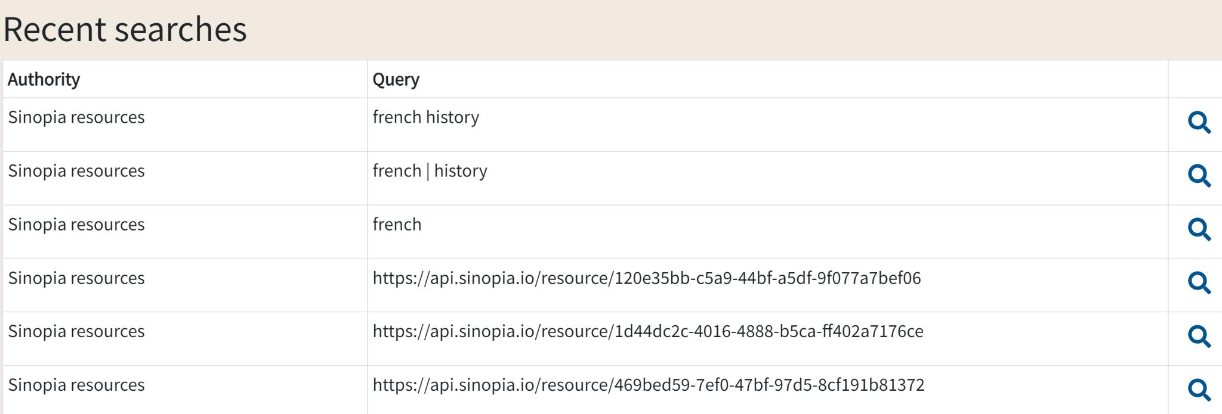
Searching from the Dashboard
The Dashboard saves your most recent searches
To quickly redo a recent search, go to the Dashboard tab and scroll down to Recent searches. Click the magnifying glass to do the search.

Slide 13
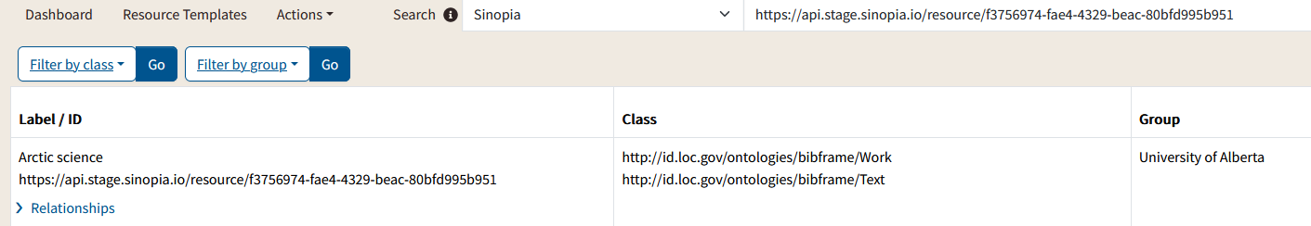
Searching by URI
Each description in Sinopia is assigned a URI when you first save it; you’ll learn in Module 7 how to save your descriptions; a description is given a URI
If you know a URI for a description, enter it in the search box.
The results include the description with that URI, and any other descriptions that refer to it.

Slide 14
End of Module 3

