Slide 1
Sinopia Module 4
About the PCC Templates

Slide 2
Scope of this module
Module 4: About the PCC Templates covers
The concept of a template
Selecting the appropriate PCC Template
Navigating through a template
The types of data you can enter in Sinopia

Slide 3
What is a Resource Template?
You can think of a Sinopia resource template, or template, like a recipe. Just like a recipe tells you what ingredients to use, a template tells you which elements you can use to catalog a particular kind of thing
For a given class, a template specifies which properties are relevant and how to record data for those properties
A template acts as a metadata application profile. To learn more about metadata application profiles, see the PCC Task Group on Metadata Application Profiles

Slide 4
PCC Templates: Background
To encourage adoption of Sinopia and standardization of cataloging in Sinopia, the PCC has provided a set of BIBFRAME-based templates for your use. These PCC templates were developed based on best practices that evolved from early use of Sinopia
As of the publication of this module, the PCC Templates are available on the Stage website (stage.sinopia.io) only

Slide 5
PCC Templates: What’s covered
Sinopia offers PCC templates for Works, Instances, and Items, for both Monographs and Serials. Each level of the BIBFRAME model (Work, Instance, Item) has its own template
Module 8: Linking Related Descriptions explains how to make links between descriptions created from the templates.

Slide 6
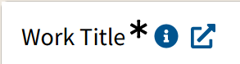
Cataloging Practice
The PCC Sinopia templates link to Original RDA guidelines whenever possible, and at times, give further instructions on cataloging practice.
As PCC catalogers gain experience with the PCC templates, additional best practices will emerge and be documented.
link to RDA
link to further instructions

Slide 7
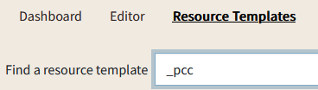
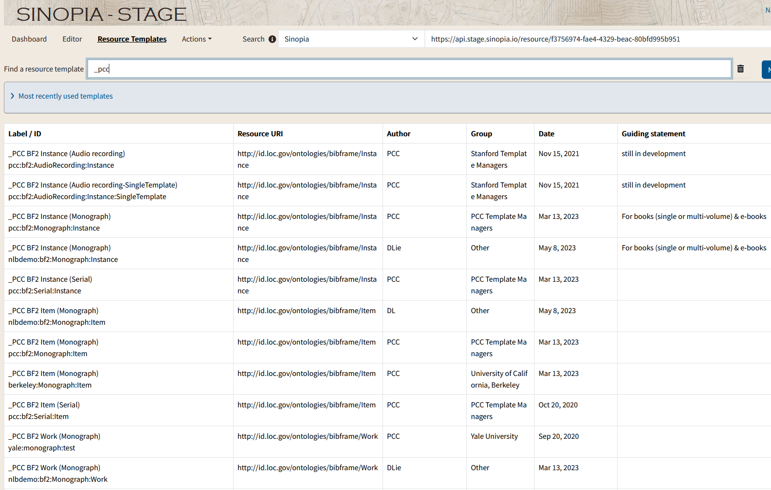
Finding PCC Templates
To begin cataloging in Sinopia, you first need to select the appropriate template. Sinopia contains many templates, most of which are not for use for PCC cataloging
To see only the primary PCC templates, click the Resource Templates tab.
In the Find a resource template box, type _pcc (underscore pcc)

Slide 8
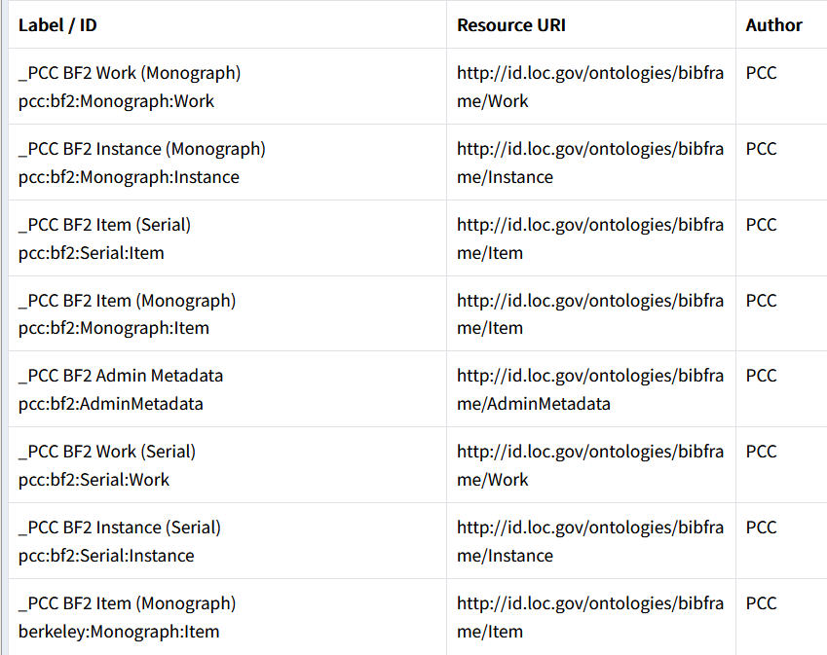
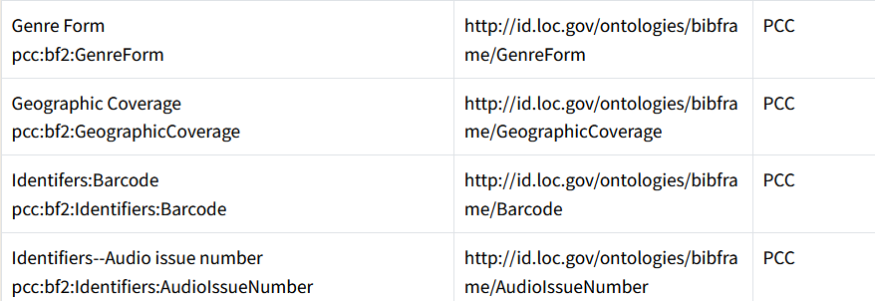
Which templates to use?
Looking at the list of templates displayed when you search for pcc, notice that the template names at the top of the list start with an underscore. These are the templates you want to open; they represent the main levels in the BIBFRAME model, such as _PCC BF2 Work (Monograph).
The templates listed farther down, like Genre Form, are smaller templates that are used within the Work, Instance, and Item templates. Although it’s possible to open these “subtemplates” on their own, in practice, you will only need to open the templates that begin with an underscore.

Slide 9
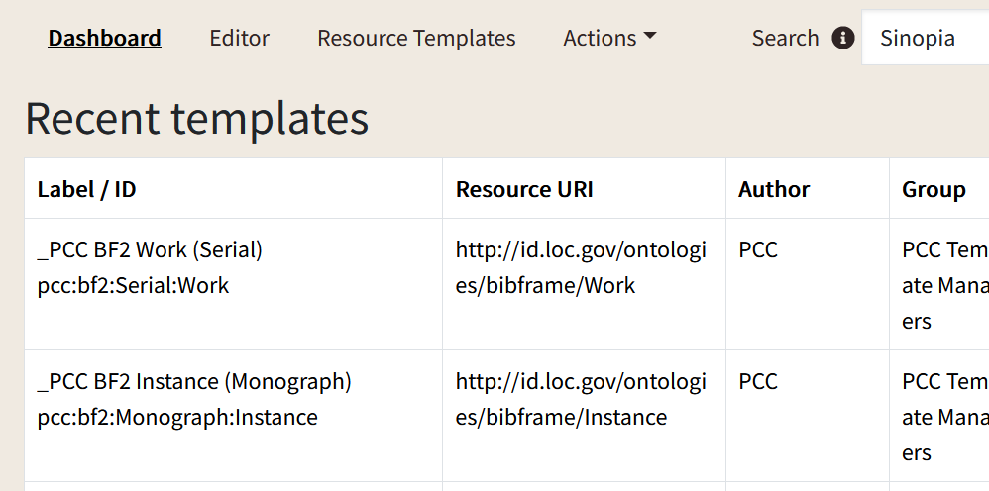
Finding templates from the Dashboard
The Dashboard tab is a quick way to get your recently opened templates. They will be listed first on the screen under "Recent templates".
When you first start in Sinopia, this list will be empty.

Slide 10
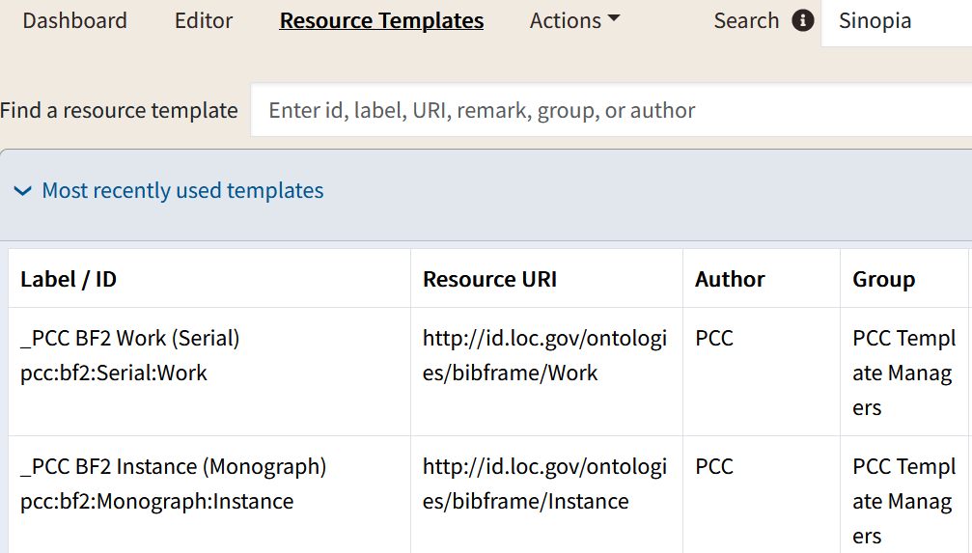
Finding templates from the Resource Templates screen
The Resource templates screen lists your most recently used templates first
Click the heading to open the list

Slide 11
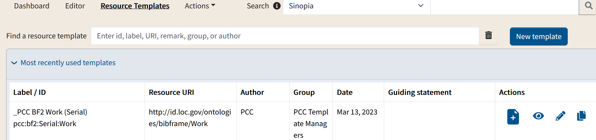
Icons associated with templates
Buttons & icons beside templates allow you to create a new description from a template, look at a version of the template as linked data, edit the template, or copy the template
you will not have all the icons; their appearance depends on your permissions
creating, editing & copying templates is not in scope with this training; only the first 2 icons are relevant here
Create a description (catalog)
View a description or template

Slide 12
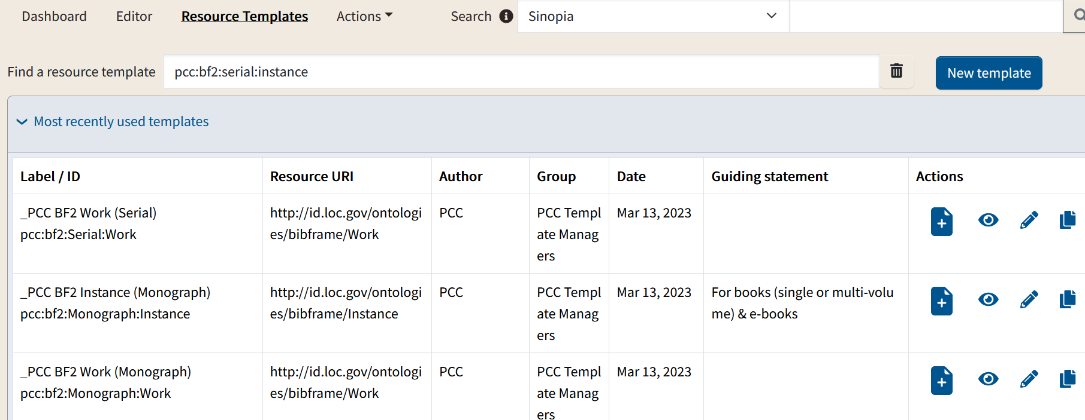
Opening a PCC Template for cataloging
Sinopia shows provides the following details about each template:
Label/ID: Template name
Resource URI: When this template is used for cataloging, the resulting resource will have this URI as its type, or class.
Author: Name of organization or person who designed this template
Group: The Sinopia group who owns the template & can edit it
Date: Date template was created or modified
Guiding statement: Notes about the template
To open a template for new cataloging, click on the "create" icon under "Actions".
Actions: Actions you are permitted to take with this particular template

Slide 13
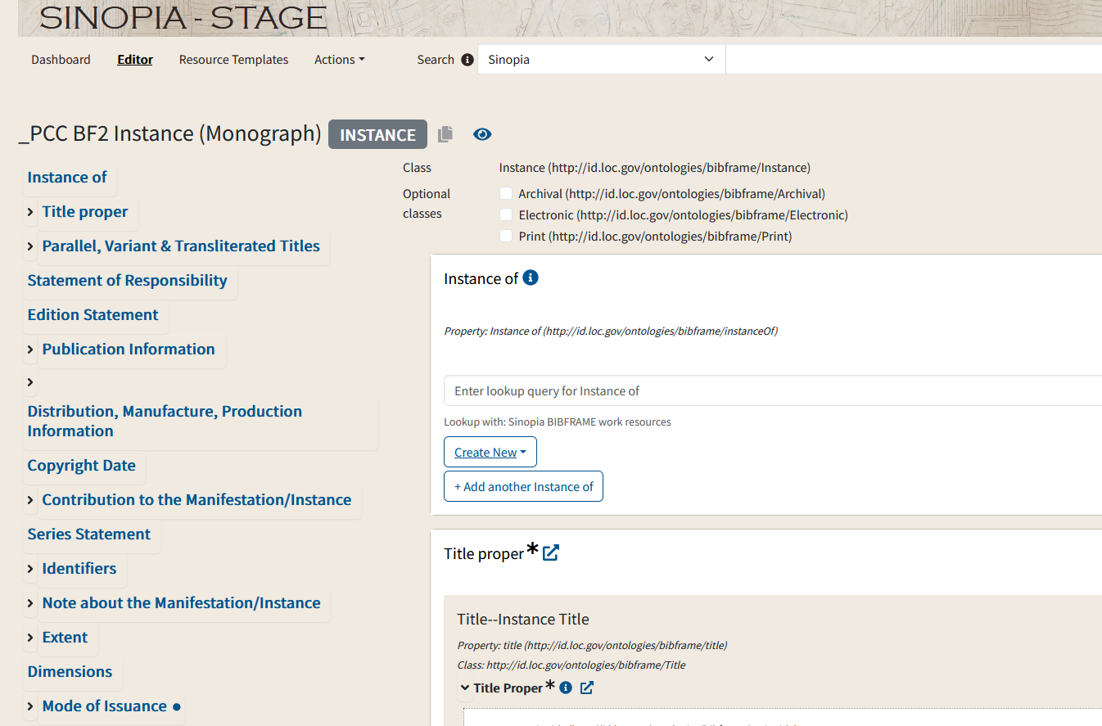
Navigating a template: Editor tab
When you click on the "create" icon, Sinopia will open the template for cataloging in the Editor tab
This is where you will enter cataloging data & create a BIBFRAME-based resource description
The following slides show how to navigate through a template on the Editor tab. Later modules explain how to enter data into the template.

Slide 14
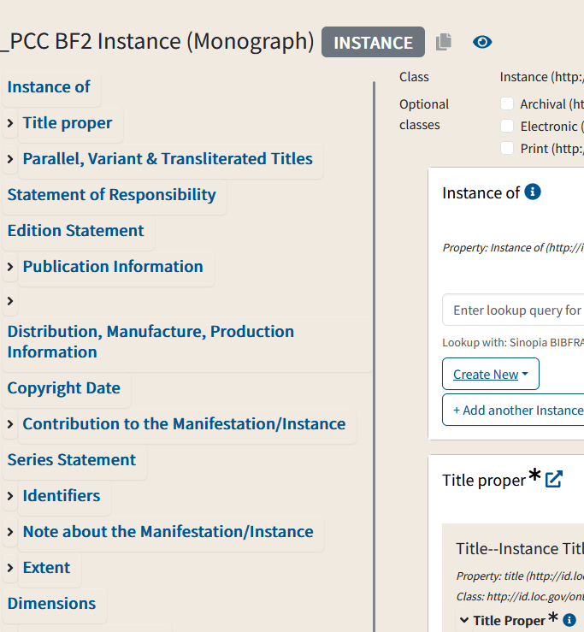
Navigating a Template: Sidebar
The left sidebar shows an overview of the template and gives you a quick way to move from one section to another.

Slide 15
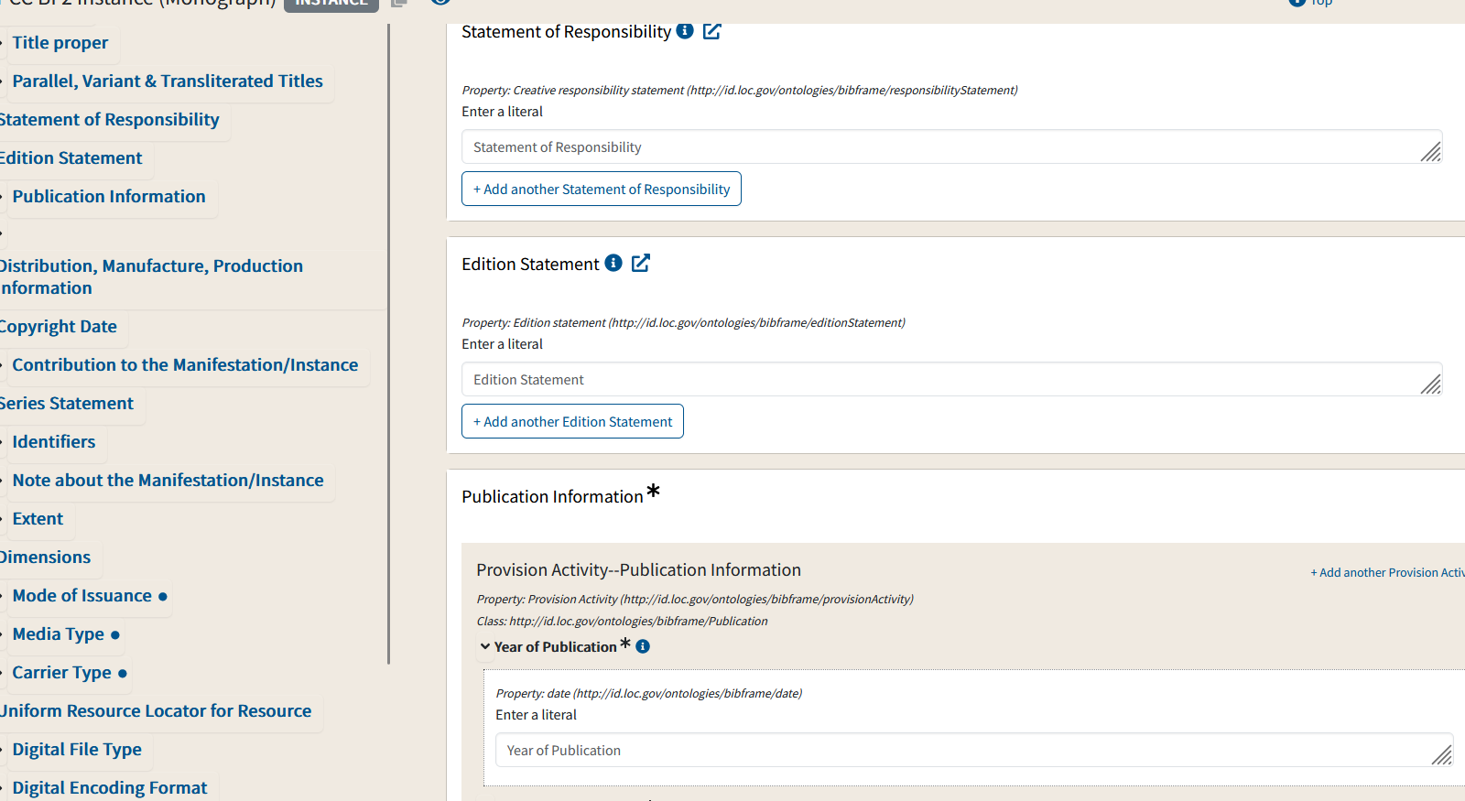
Navigating a Template: Fields
On the right side of the window are the fields themselves. Each field where you can enter data corresponds to a BIBFRAME property.

Slide 16
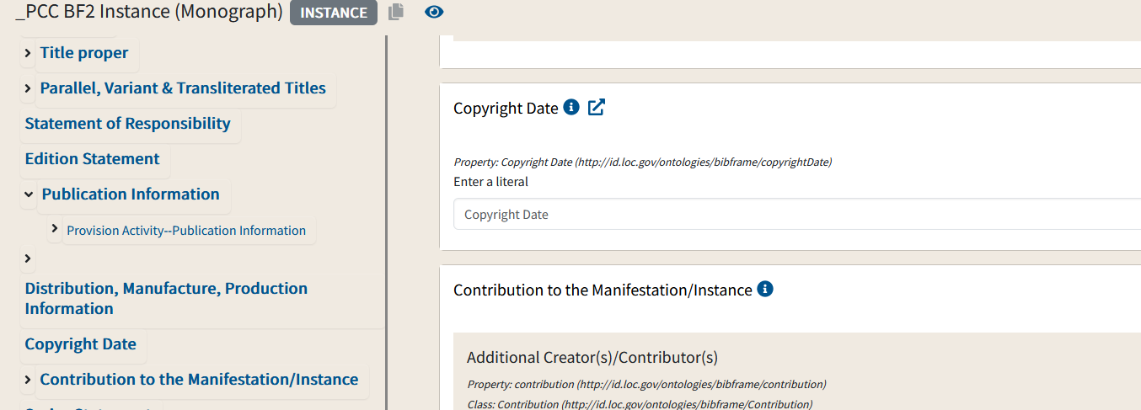
Navigating a Template: Sidebar
When you click a field name in the left sidebar, the right side of the window shows the corresponding field.

Slide 17
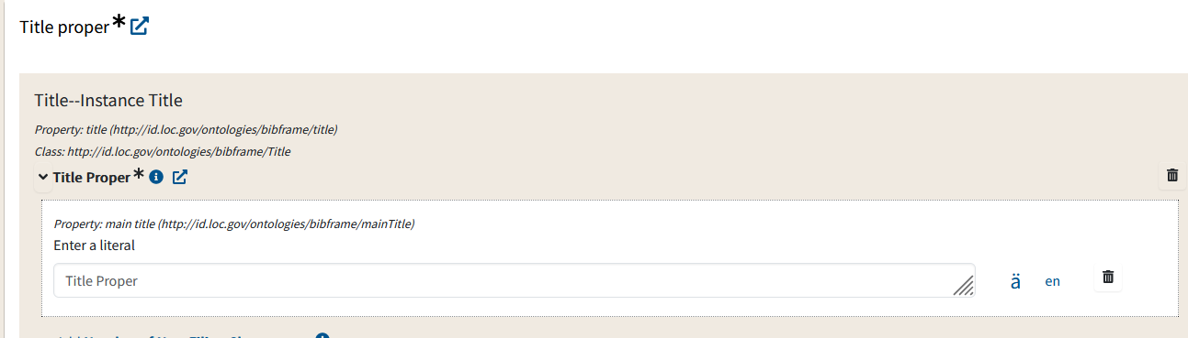

Navigating a Template: RDA Toolkit links
If you hover your cursor over the icon, the RDA rule number will appear.
The icon of the box with the arrow is a direct link to the appropriate guideline in the Original RDA Toolkit.

Slide 18
Navigating a Template: Mandatory fields
Mandatory (required) fields are identified by an asterisk (*). If you leave a mandatory field blank, Sinopia will not permit you to save a description & highlight empty fields in red.

Slide 19
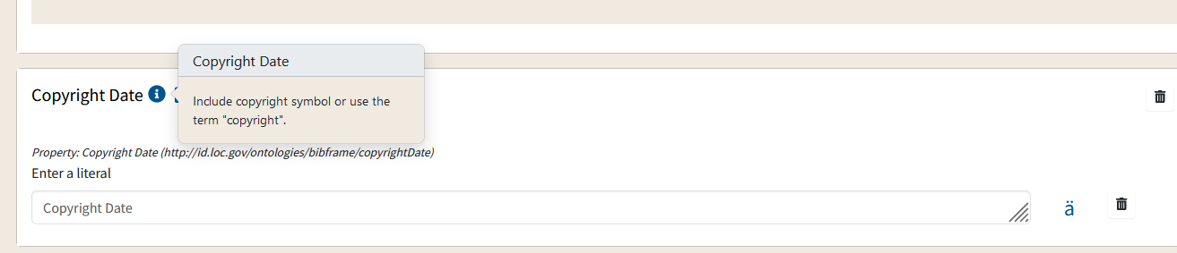
Navigating a Template: Further Information
Clicking on the "i" button will open a box containing clarifications on best practices or how to enter the data.

Slide 20
Navigating a Template: Subtemplates
A flat list of fields can’t express everything you want to express in linked data. For example, a Work has a Contributor, and the Contributor has a Role. If the Work has more than one Contributor, a flat list of fields can’t express which Role goes with which Contributor.
This type of situation is handled by embedding a smaller template so that you end up with a set of fields that stays together and works as a unit.
Notes:
Screenshot of

Slide 21
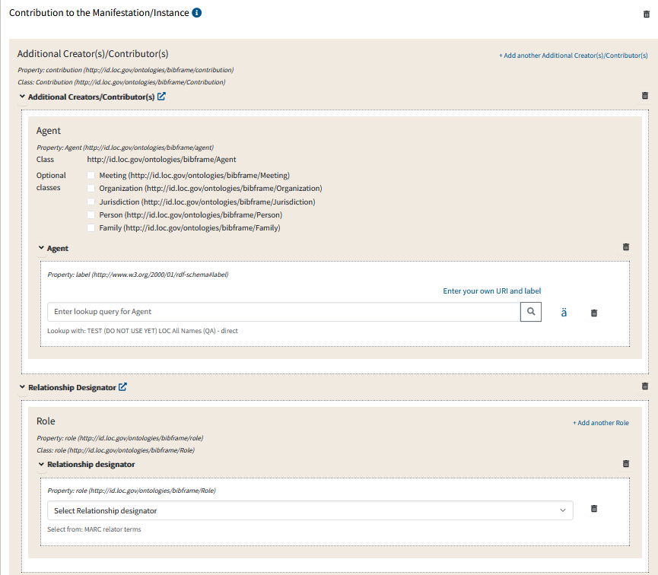
Subtemplate Example: bf:Contribution
bf:Work
bf:Contribution
bf:Agent
bf:Role

Slide 22
Data entry methods in Sinopia
Templates in Sinopia uses two basic data entry methods: Literals and Lookups. Module 5: Entering Literals and Module 6: Entering Data Using Lookups explain how these data entry methods work.
Literals
Used to record transcribed data
Not machine-actionable, but they are human-readable
Lookups
Used to enter URIs and labels from external vocabularies
Notes:
Screenshot of

Slide 23
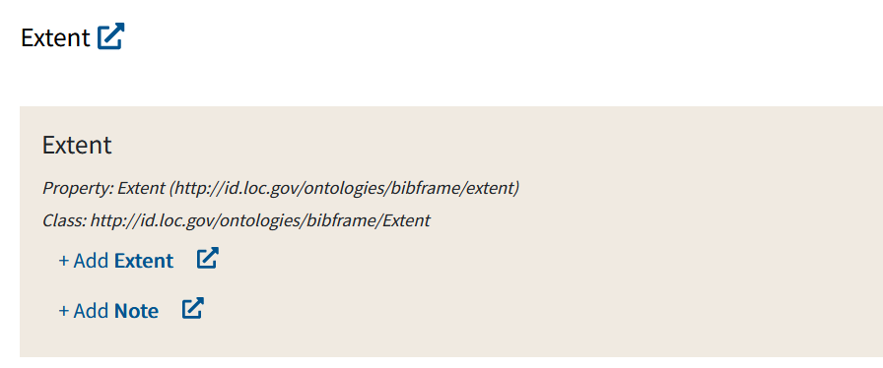
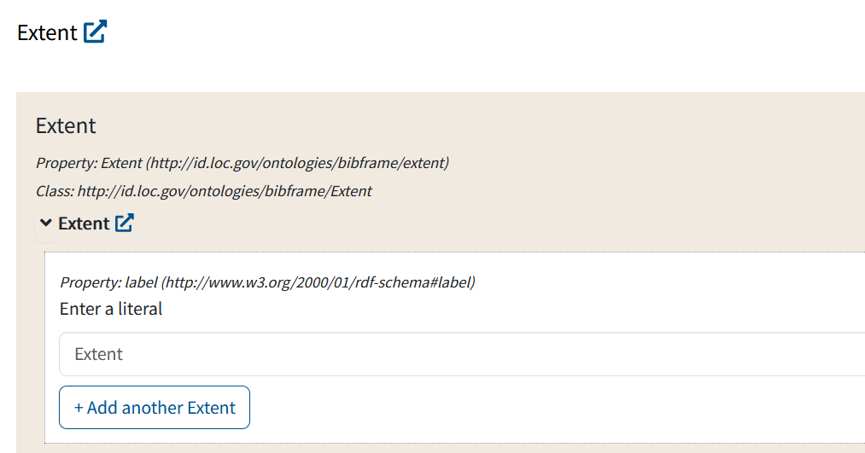
How to expand a subtemplate
The following examples use the _PCC BF2 Instance (Monograph) template.
The internal fields of a subtemplate are not generally “open” or “expanded” when you open the template. Click the +Add button to expand a field.
The field expands to show you a literal field or lookup field.

Slide 24
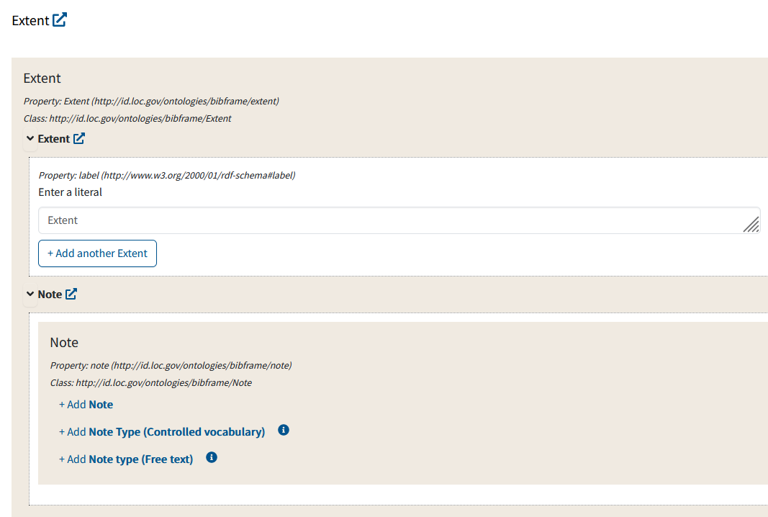
Multiple levels of subtemplates
In this example, we expanded Extent, but no fields are open for Note yet. You have to expand again with +Add.

Slide 25
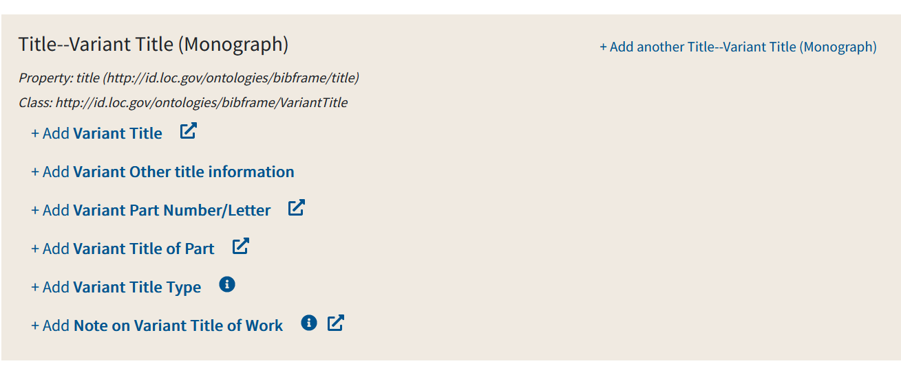
Using a subtemplate more than once
If you have more than one Variant Title, you need to duplicate the entire subtemplate, using the +Add another button.
The properties in a subtemplate work together as a group. Here you can enter all the component parts of a variant title under the umbrella class of bf:VariantTitle.

Slide 26
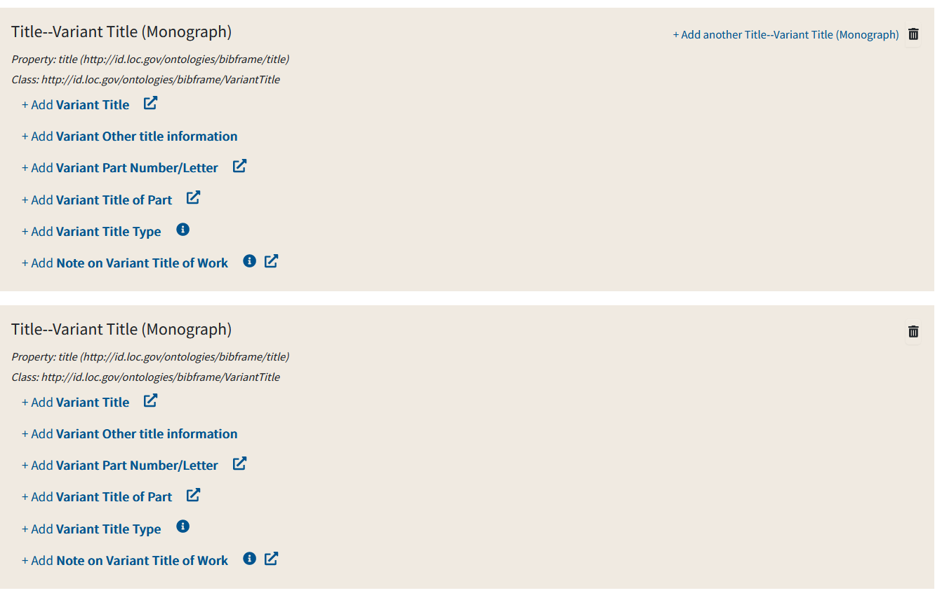
Result of +Add another
After clicking +Add another an entire duplicate subtemplate will appear.

Slide 27
End of Module 4

