Slide 1
Sinopia Module 5
Entering Literals

Slide 2
Scope of this module
Module 5: Entering literals covers
Entering data as strings, or “literals”
Editing literals
Specifying the language of entered literals

Slide 3
About literals
Used to record transcribed data or notes
Not machine-actionable, but they are human-readable
Examples of fields that expect literals: Title proper, Subtitle, Edition statement, Note

Slide 4
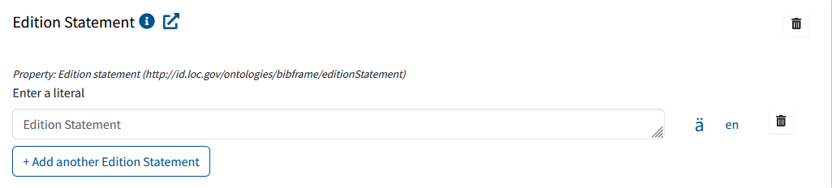
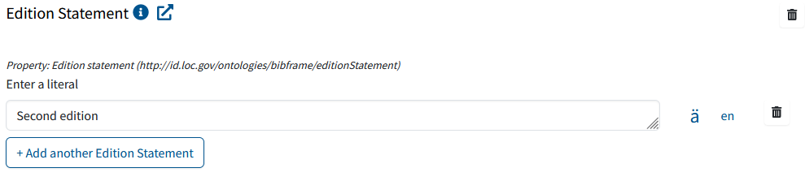
How to enter and edit literal metadata
The following examples use the _PCC BF2 Instance (Monograph) template.
A field that expects a literal is a text-entry box, with the field name shown in the box. Click in the box to type
To edit metadata, click again in the box if necessary. Use delete or backspace keys to edit or double-click on text string to write over.
If you want to delete the data entirely, click the trash icon. Do not just delete the text.

Slide 5
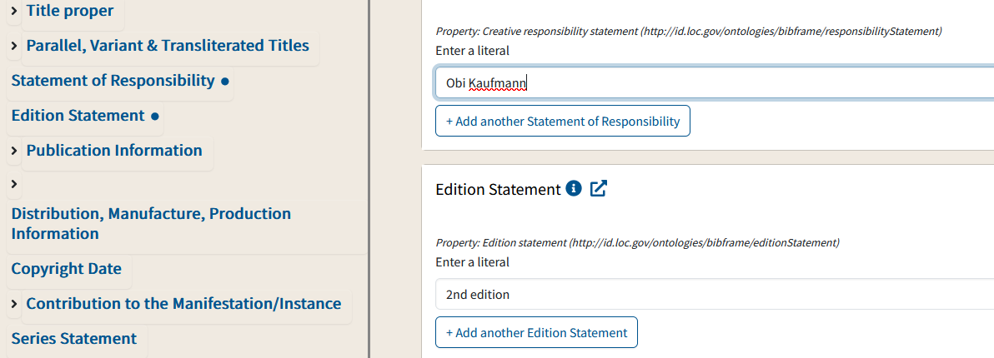
Using the sidebar to see completed fields
If you save your work after you enter data in a literal field, a dot appears next to the field name in the left sidebar, showing that the field is complete.

Slide 6
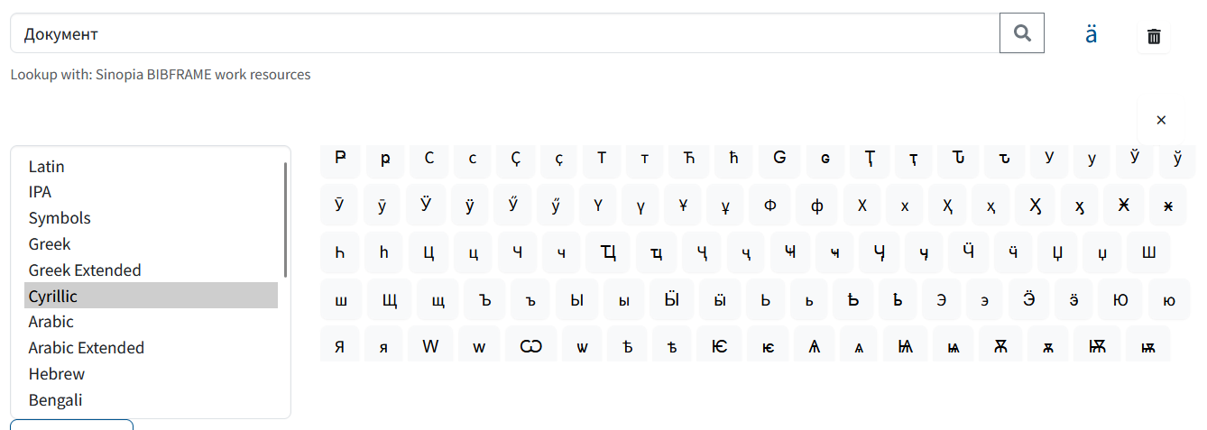
Diacritics and character sets
Click the “ä” button to open a virtual keyboard for inputting characters from a number of different character sets.

Slide 7
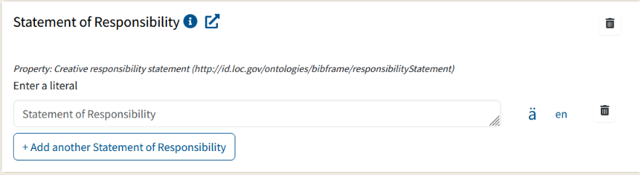
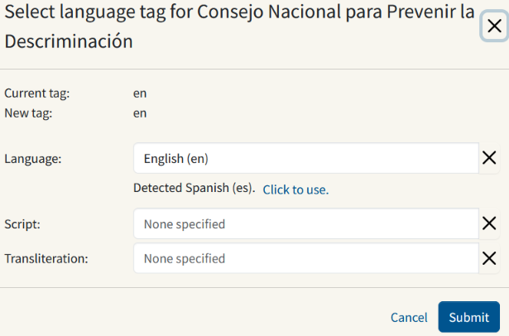
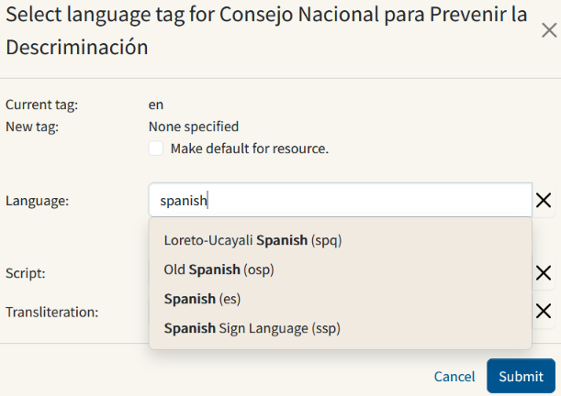
Language of literals
For transcribed data, use the Language button to note the language used to express the literal. When you first input a literal, the Language button defaults to English.
To edit the stated language, click the Language button, then either select the detected language by selecting the “Click to use” or search for and select a language that matches the literal. Then click Submit.

Slide 8
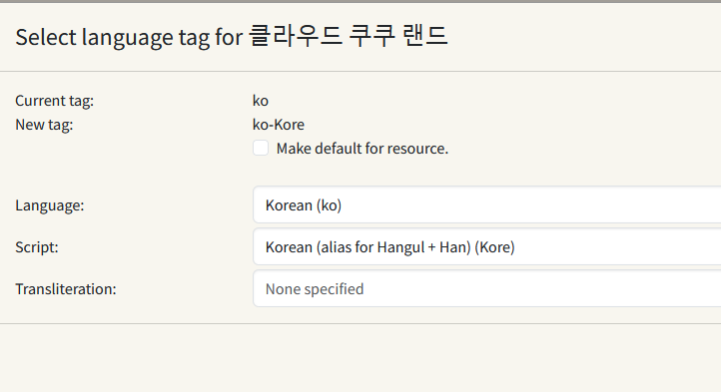
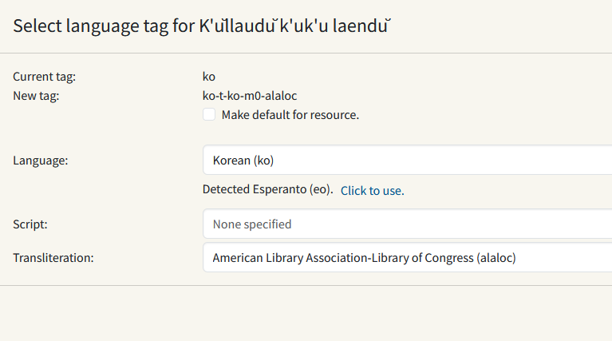
Script or Transliteration of Literals
The script or transliteration scheme for the literal can also be coded.
Instance title
Transliterated title
Note how the tag expands in each to add the additional code. Remember, the tag refers only to the literal (string) it is associated with only and no other.

Slide 9
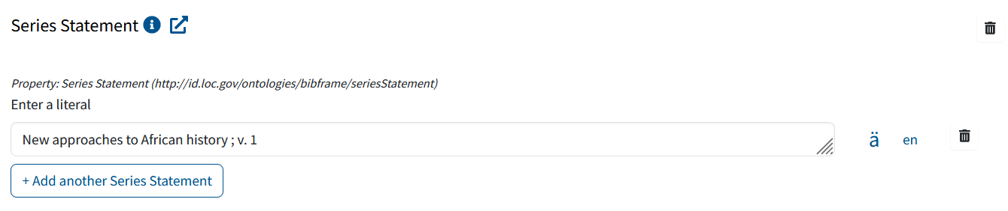
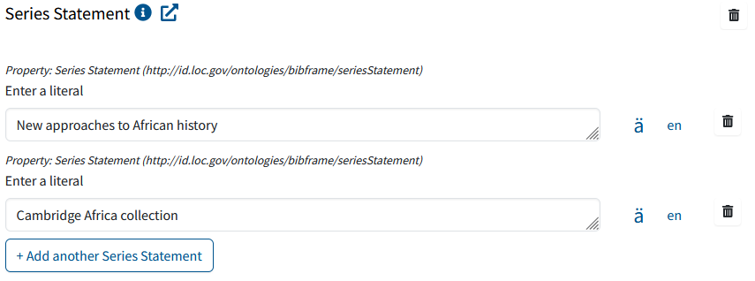
Repeatable literals (strings)
To add more than one value for a field, type one value.
Then click on the button to add another field for entry.
Click in the box to type the value.

Slide 10
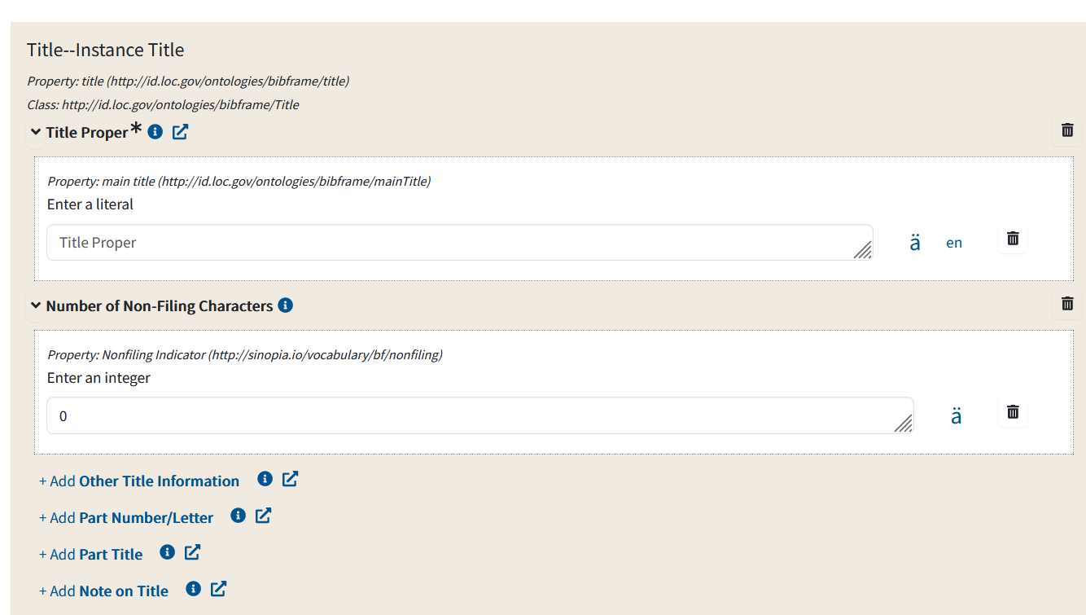
Non-repeatable literals (strings)
Some literals are not repeatable. An example is Title proper (Instance Title).
Title proper (Instance Title) (and its individual fields) are non-repeatable. Because of this you will not see "Add another Title--InstanceTitle", "Add another Number of Non-Filing Characters," "Add Other Title Information", etc.

Slide 11
End of Module 5

