Slide 1
Sinopia Training Module 6
Entering Data Using Lookups

Slide 2
Scope of this module
Module 6: Entering Data Using Lookups covers
Entering data by using dropdowns & lookups to external authoritative sources (e.g., Library of Congress vocabularies at id.loc.gov)
Adding URIs & labels manually

Slide 3
Use of lookups
Because linked data relies on URIs to represent entities, your metadata will be the most useful when as much of it as possible is represented as URIs, rather than strings.
When you use a lookup in Sinopia, you are searching through sets of terms to find the right one to use in your metadata. When you select a term, Sinopia displays the term and also saves the corresponding URI.
Questioning Authority (QA) is the service that provides the access to many vocabularies in Sinopia.

Slide 4
Limitations of Lookups
QA uses APIs provided by vocabulary holders to populate lookups
  Benefits
    vocabularies are current (not reliant on updating local caches)
    lower maintenance
  Drawbacks
    we are limited to data providers’ API choices about search relevancy, provided context, and display results, although we do provide links to individual authorized terms in id.loc.gov
    because of this, you will still often need to use the full authority files in id.loc.gov & OCLC to choose the correct term

Slide 5
Types of lookups in Sinopia
Sinopia offers two methods of lookups: drop-down lists and lookup components.
Drop-down list
for short lists of terms where the context of the term in the list is valuable and the values are stable, e.g., content types
these lists are cached in Sinopia & not true lookups
Lookup with query box
for larger, more dynamic vocabularies, such as LCGFT, LC-NAF/LC-RWOs, LCSH

Slide 6
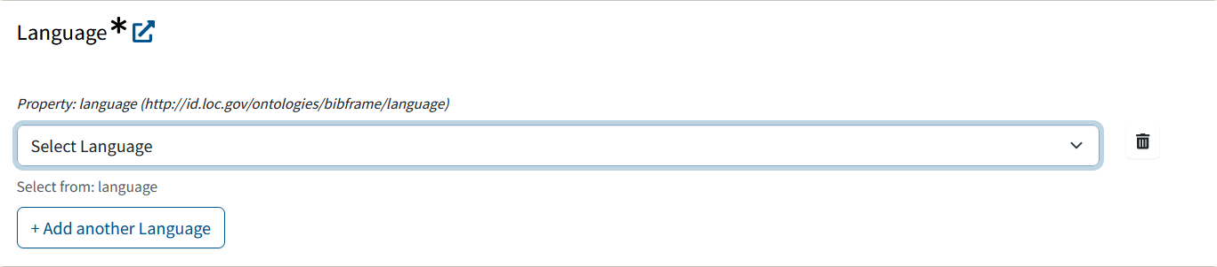
About drop-down lists
This example uses the _PCC BF2 Work (Monograph) template.
A field with a drop-down-style lookup contains the text “Select…” in the entry box, with a down-arrow on the far right.
To open the drop-down, click anywhere in the field.

Slide 7
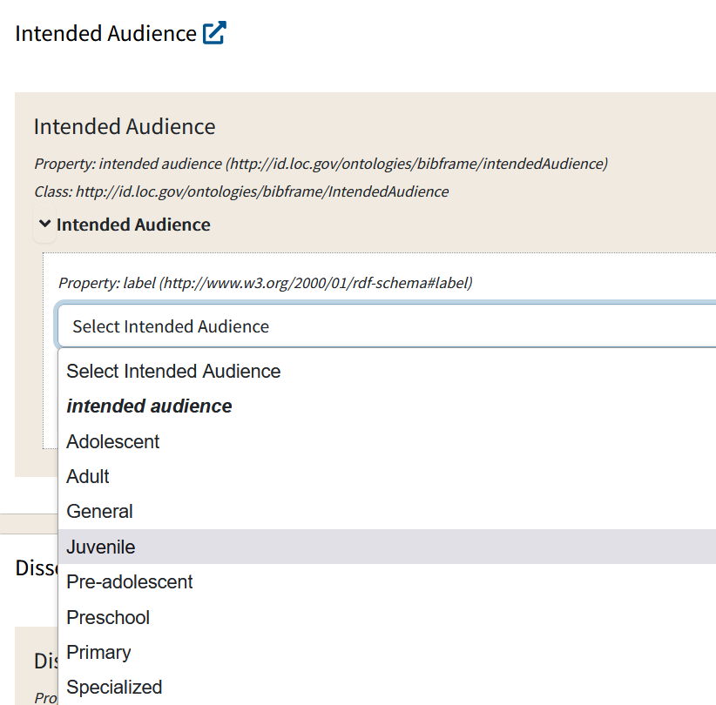
Selecting values from drop-down lists
Each item in the list represents a URI from the external vocabulary.
Labels are in alphabetical order in the dropdown list.
To select an item from the list, click the item.
To close the drop-down without selecting an item, just click on the empty space beside the list or hit Esc.

Slide 8
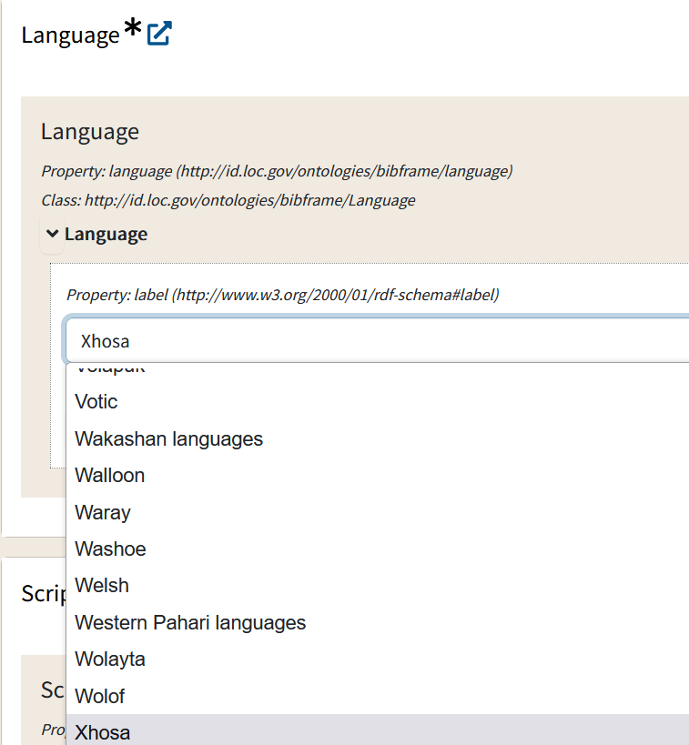
Type Ahead for Long Lists
Instead of scrolling through a long list, you can also do a type ahead
Example:
If you want the language "Xhosa", start typing the word in the search box. You will jump down to Xhosa immediately rather than having to scroll through the whole list.

Slide 9
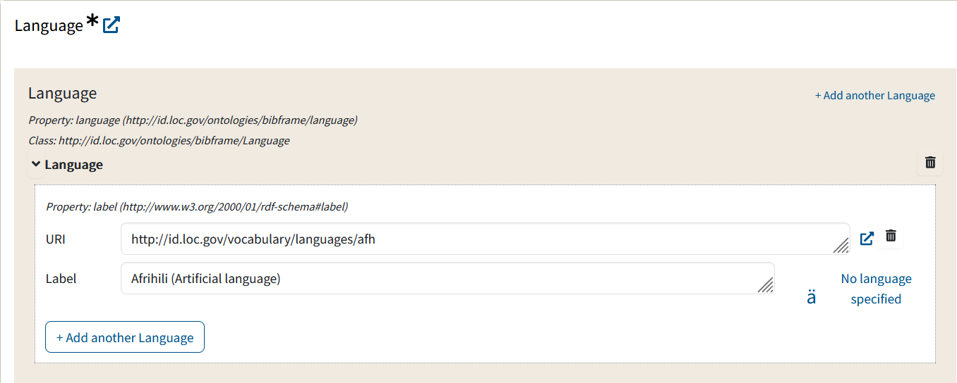
Editing values in drop-down fields
After you select a term, its URI and label are automatically filled in.
To edit the value you entered click on the “trash can” icon to delete the value you entered, and then open the drop-down list again to choose a new value

Slide 10
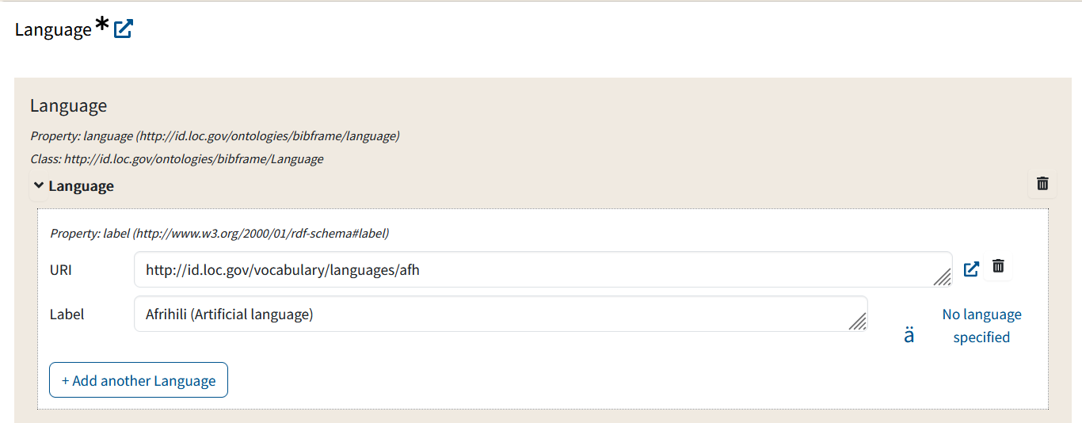
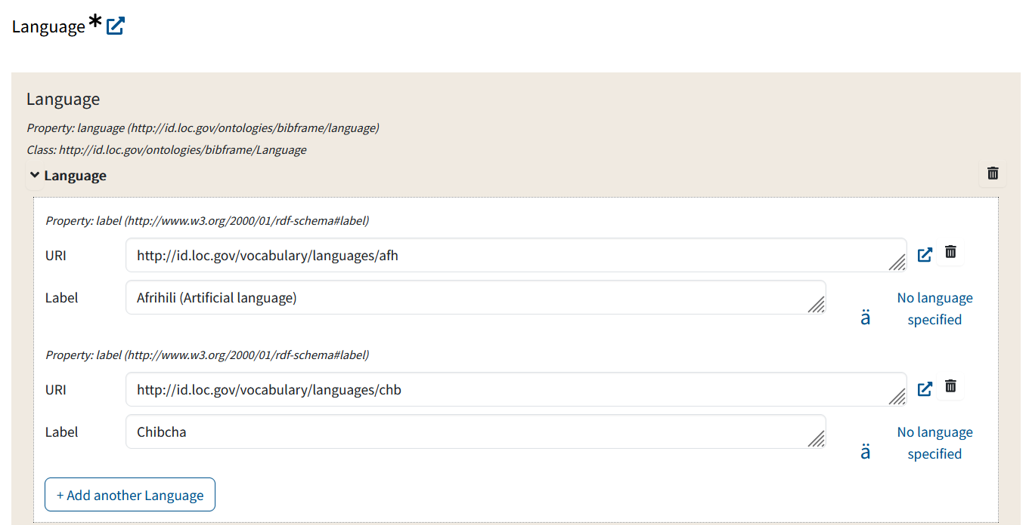
Repeatable values in drop-down fields
To enter more than one value in a drop-down field, select one value...
Click on the “+Add another…” button
… and choose another value.

Slide 11
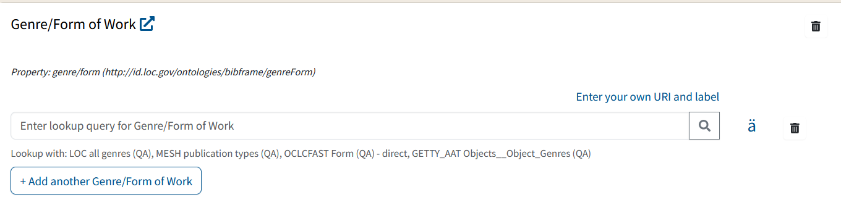
Lookup Queries for Larger Vocabularies
For external authoritative sources for larger or more dynamic vocabularies, Sinopia has a Lookup query that lets you search the external source and select a result.
A field with a Lookup Component contains the text “Enter lookup query for…” in the entry box, and has a Lookup button in the shape of a magnifying glass.

Slide 12
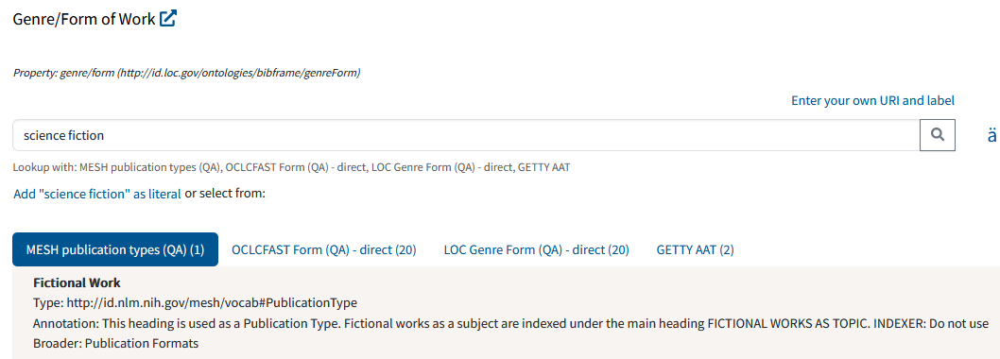
Doing a Lookup query
Type a value in the Lookup box.
Click the Lookup button or press Enter to search the external vocabulary.
Your search results will appear. If there are multiple vocabularies provided, the results of the first one will be displayed by default with any context provided by the API. For other vocabularies, the number of hits will be listed after the vocabulary name.

Slide 13
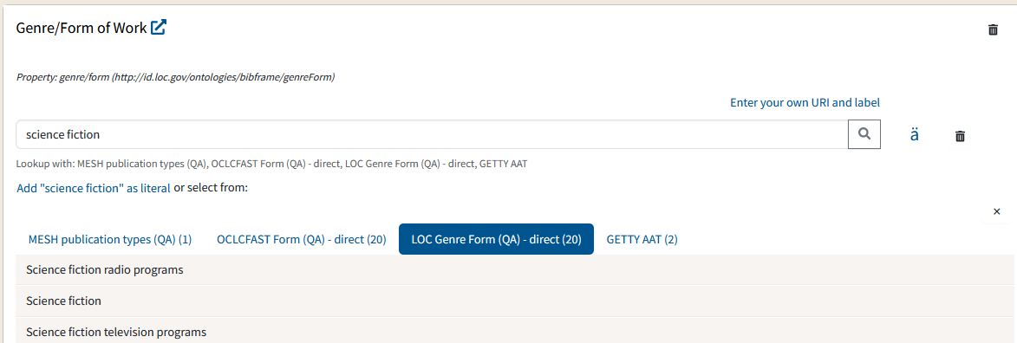
Changing vocabularies
To display the search results of a vocabulary other than the default, click on its name. The search results for that vocabulary will display.

Slide 14
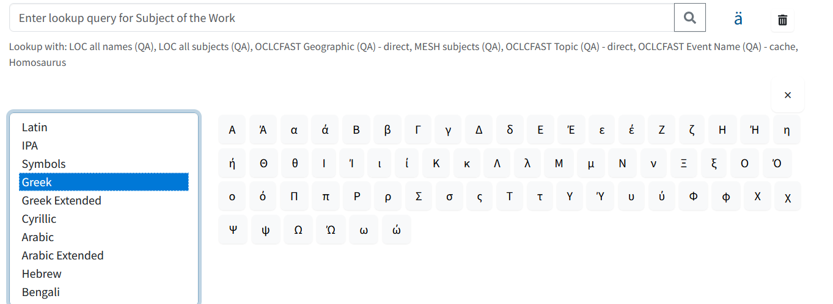
Diacritics and character sets
Just like in literal fields, you can click the “ä” button to open a virtual keyboard for inputting characters from a number of different character sets.

Slide 15
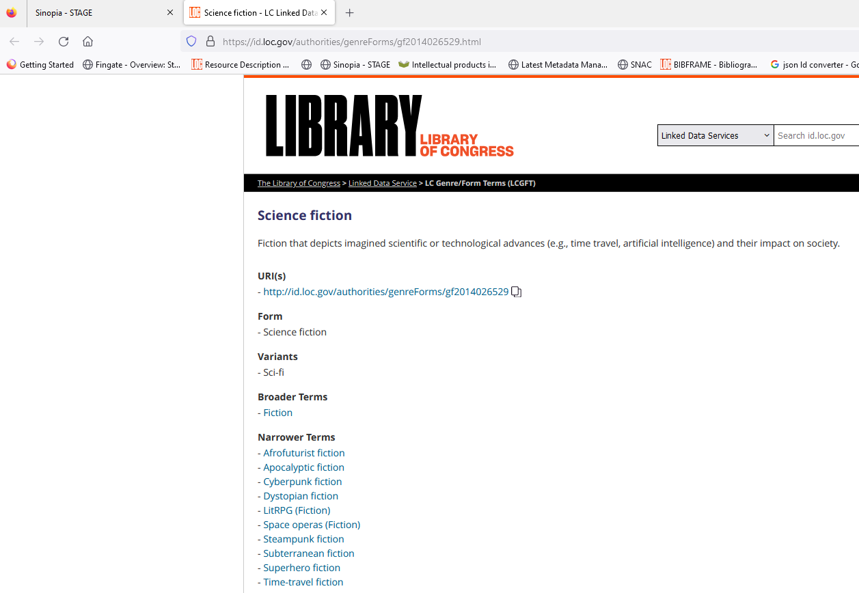
Viewing the Full Record
When you click on the external link icon, the record for the term is displayed in a new browser tab.

Slide 16
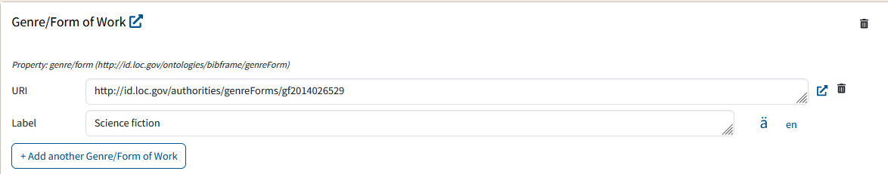
Editing your selection
To edit your selection, click the trash can icon to remove it, and then do another lookup.

Slide 17
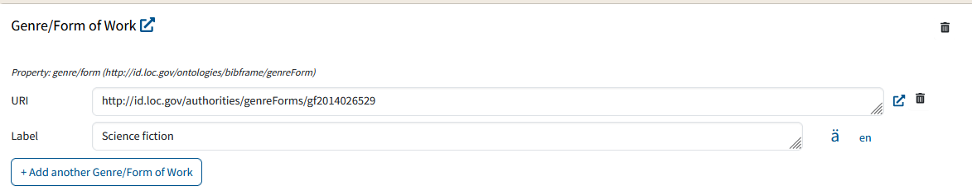
Selecting a result
Click on your desired result to select it.
The URI and label are now displayed in place of the lookup box.
The “external link” icon is a link to the URI represented by the label. From here, you can go to the full record for the term you have chosen.

Slide 18
Repeatable lookups
You can do multiple searches and select multiple values in repeatable lookup fields. After selecting a value, click the “+Add another…” button to do another lookup and choose your next value.

Slide 19
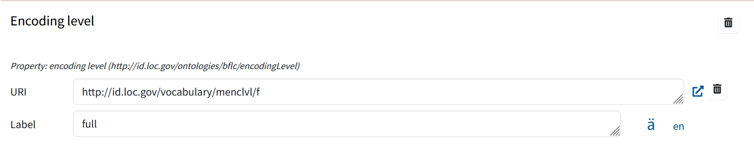
Non-repeatable fields
In the Encoding level field, note the lack of a “+Add another…” button. This means only one value is allowed in the Encoding level field.

Slide 20
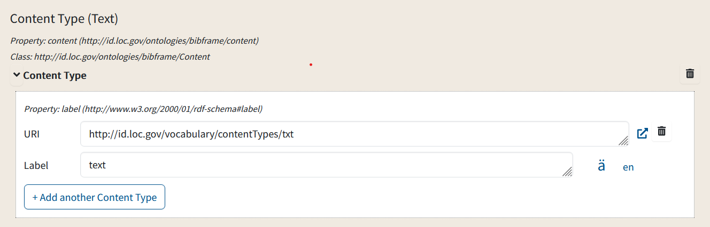
Default values
Some fields are pre-populated with a default term.
To edit the default, click the trash can icon next to the term; this will remove the default term
Use either the drop-down list or lookup (depending on the field) to search for & enter a new term.
This value is pre-populated based on the chosen template (monographs in this case)

Slide 21
Tips on Using Lookups
You may need to type the entire string for the desired heading to appear in the list.
Lookup is sometimes sensitive to case, punctuation and spacing. Try typing capitalization and punctuation exactly as it appears in the authorized heading.
The results are presented in order by relevance, but the order may not be predictable.
You may have to try more than one form of the heading to get to the desired results (such as a cross ref form).
At times you may need to look in outside resources such as OCLC or id.loc.gov.

Slide 22
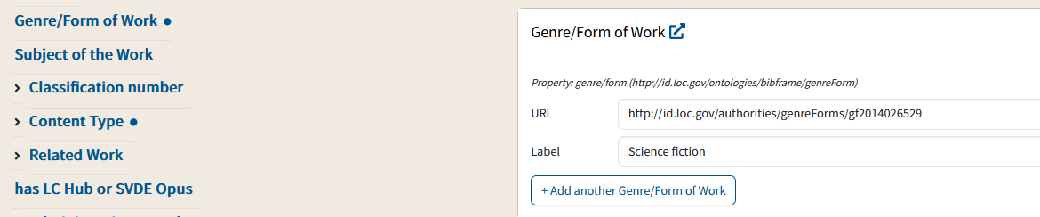
Using the sidebar to see completed fields
After you enter data in a lookup field, a dot appears next to the field name in the left sidebar, showing that the field is populated.

Slide 23
Lookups to existing data in Sinopia
Some lookup fields do not search external vocabularies, but instead are lookups to Works or Instances already created in Sinopia.
These lookups are covered in Module 8: Linking Related Descriptions.

Slide 24
When you can’t find a URI
You may encounter a situation where you know an entity exists in an authoritative vocabulary, but there is no lookup available in Sinopia or the new entity is not yet available for use.
A common example is a newly created entity in the LC Name Authority File (LC-NAF). The entity exists, but because of the time lag in a new authority reaching id.loc.gov and receiving a URI, the newly created entity won’t show up in your lookup search results.

Slide 25
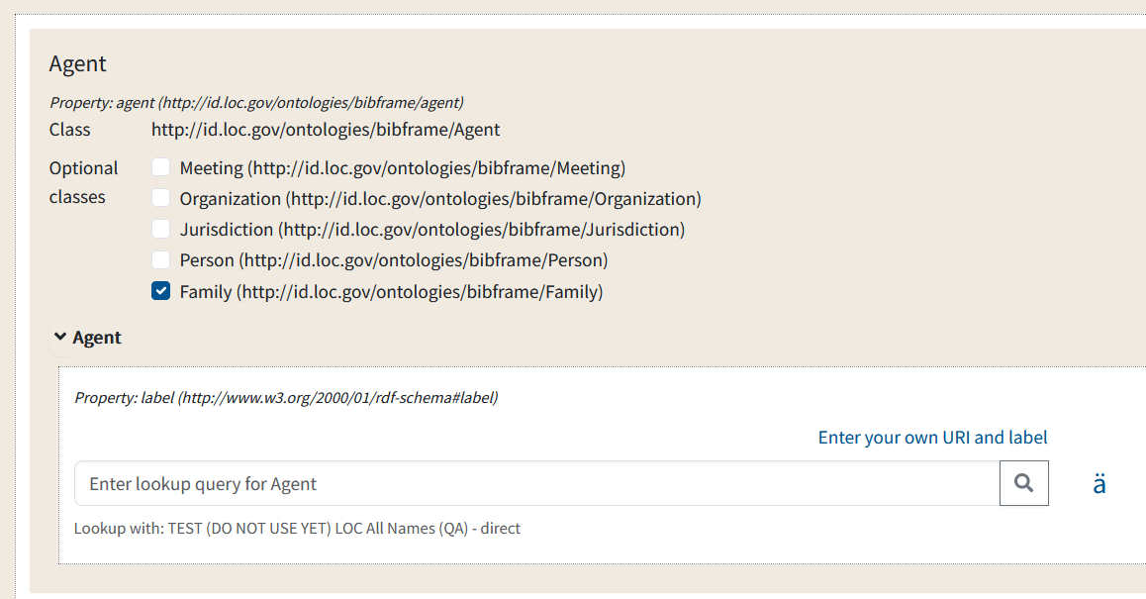
Entering your own label & URI
If you know what the label & URI are (or will be in the near future), you can enter them manually
Click on "Enter your own URI and label

Slide 26
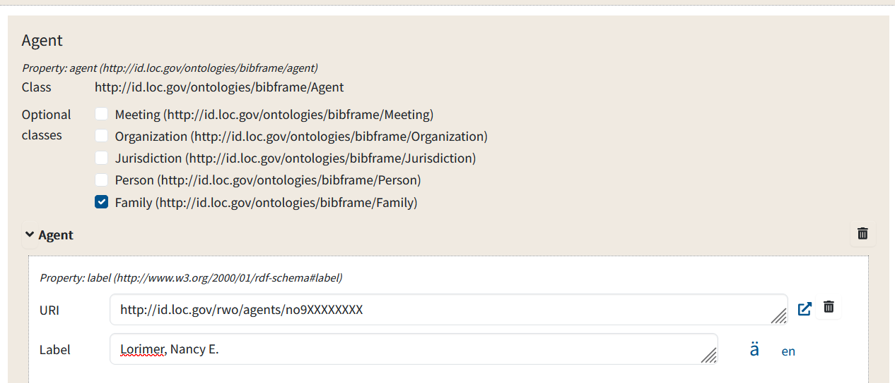
Entering your own label & URI
If you know what the label & URI are (or will be in the near future), you can enter them manually
The view will change to provide a place for you to enter both

Slide 27
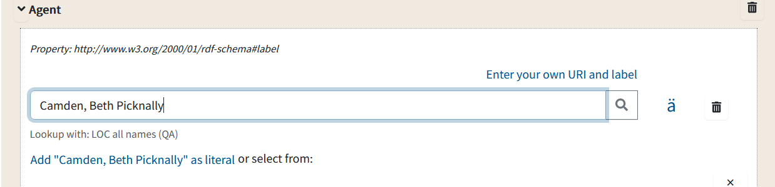
Manually adding a literal in place of a URI
If you are unable to retrieve your desired heading and cannot find an external URI for your heading either, you can add the string as a literal.
Type or paste the string in the query box and hit the Enter key or Lookup button.
At the top of the lookup results will be the option to add the string as a literal.
Click the “Add [string] as literal” line to select this literal as your value.

Slide 28
Drawbacks of manual additions
Manual additions (whether a URI + label or simply a label) work well within the BIBFRAME environment
They do not work as well when converting BF to MARC
  Problems you may encounter:
    conversion will fail because the URI does not validate
    conversion will fail because it expects a URI, not a literal
There are workarounds, but these are beyond the scope of this training

Slide 29
End of Training Module 6

