Slide 1

Sinopia Module 7
Previewing, Saving, and
Editing Descriptions

Slide 2
Scope of this module
Module 7: Previewing, Saving, and Editing covers
Previewing your description in different formats
Saving your description
Editing previously saved descriptions

Slide 3
Previewing RDF
When cataloging, click the “eye” icon to preview the RDF that is being created. The preview reflects all the data you’ve entered, even if you haven’t saved your description yet.

Slide 4
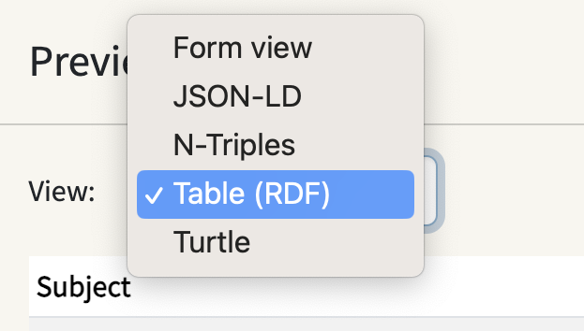
Previewing RDF
You can choose from five format views:
  Form view
  JSON-LD
  N-Triples
  Table (default view)
  Turtle
You can save your description at this point (scroll to the bottom of the preview), or click the “x” in the top right corner to close the preview.

Slide 5
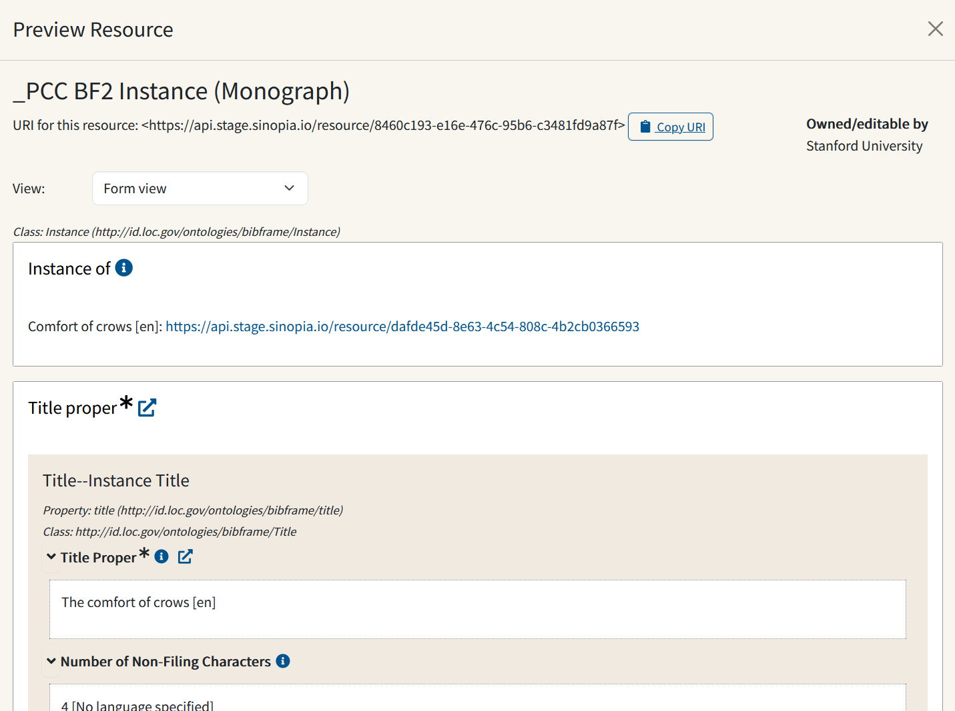
RDF Preview Formats
Form View

Slide 6
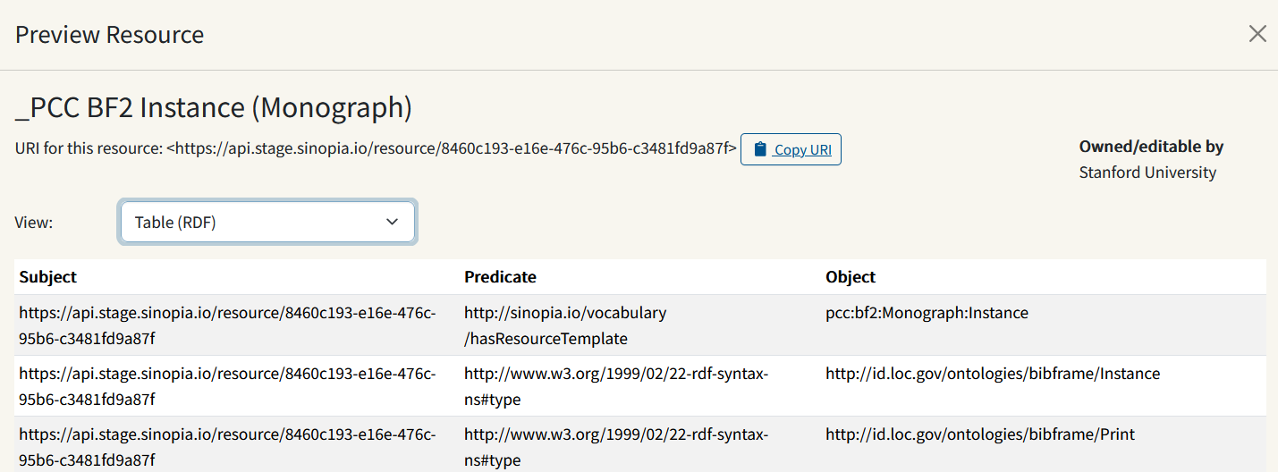
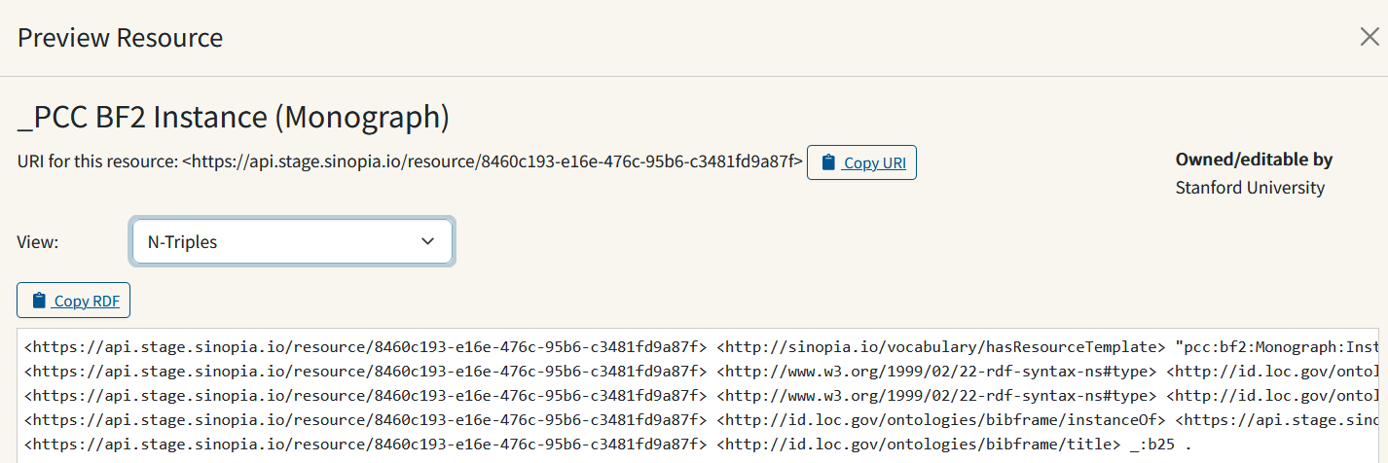
RDF Preview Formats
Table (RDF)
N-triples

Slide 7
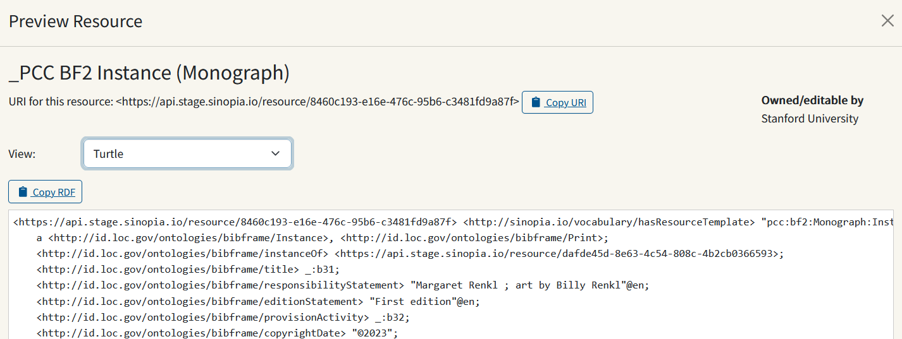
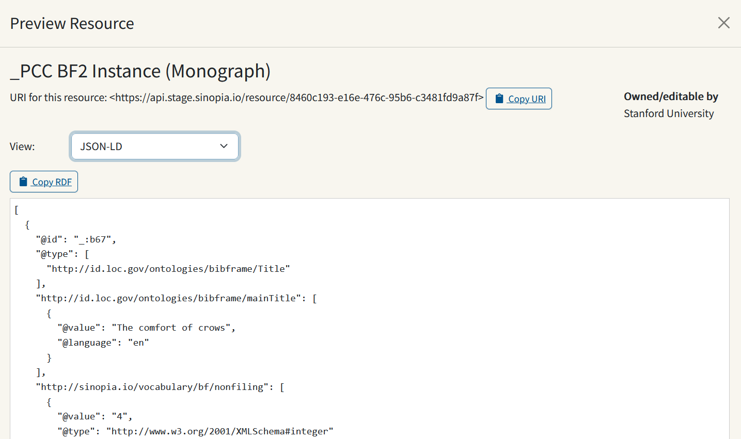
RDF Preview Formats
Turtle
JSON-LD

Slide 8
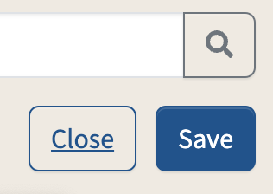
Saving a description
IMPORTANT: Sinopia does not save your data automatically as you add it. You must manually click Save to save your data.
Click the Save button at the top of the Editor screen. Use as often as you like.

Slide 9
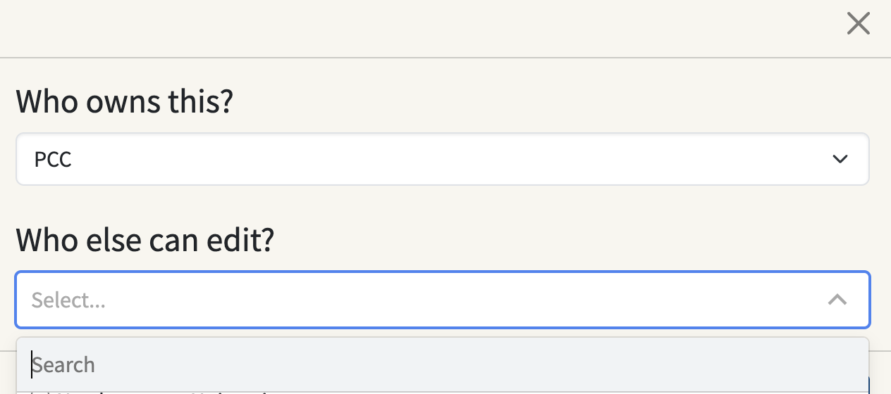
Saving a description: Record owner & editor
When you first save a description, you get a pop-up asking “Who owns this [record]?” and “Whose can edit?” For BIBCO records, choose PCC for the first question, a blank value for the second and click Save.

Slide 10
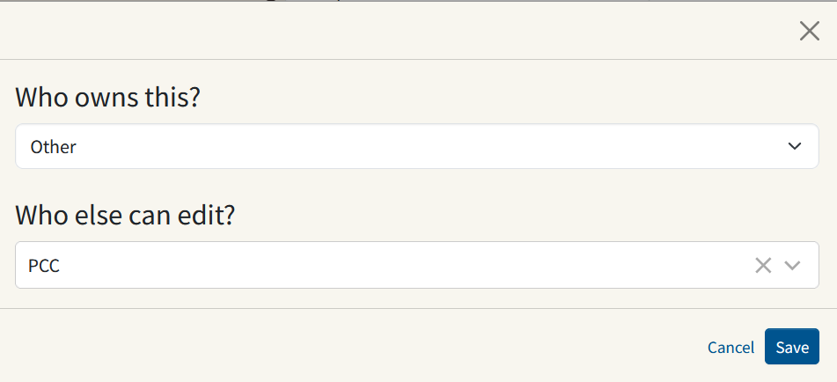
Saving a description: Record owner & editor
If you are using a PCC template, but not cataloging at BIBCO level, make your own institution (or other if your institution is not a participant group) and for "Who else can edit", select PCC. That means PCC libraries can upgrade your record.

Slide 11
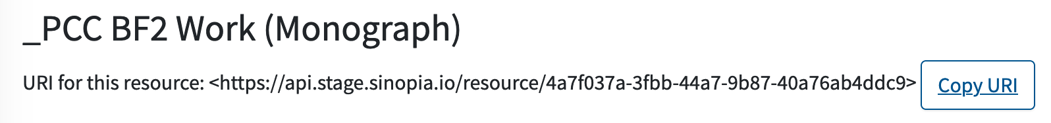
Saving a description: URI assigned
Once the description has been saved, it is assigned a unique URI. Your resource is now searchable in Sinopia from the Search tab. (See Module 3: Searching for Data Created in Sinopia.)
To copy the URI to a clipboard, click the Copy URI button. This is useful for keeping track of the URIs for the descriptions you have created, or for returning to a description for additional editing, or for creating links among descriptions. (See Module 9: Linking Related Descriptions)

Slide 12
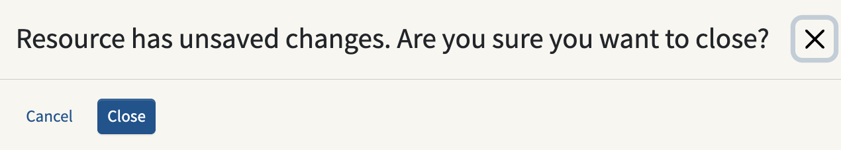
Closing without saving
To leave your editing session without saving your edits, click the Close button. If you have unsaved edits, you’ll get a message asking if you’re sure you want to proceed. Click Close to discard your edits and close the window. Click Cancel to continue working on your description.

Slide 13
Editing previously saved descriptions
To edit something you already saved, you need to find the description again and open it.
Search for the description. See Module 3: Searching for Data Created in Sinopia, or for recently completed descriptions, go to the Dashboard tab and look under Recent resources
Make your edits and click Save. The URI remains the same, and you are not prompted to choose a group.

Slide 14
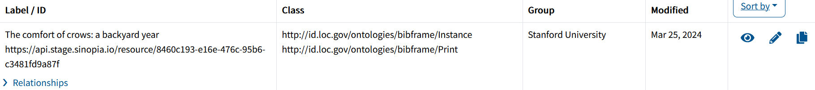
Editing previously saved descriptions
Click on the pencil icon (edit) beside the description; if you do not see the pencil, you do not have permission to edit the description
Make your edits and click Save. The URI remains the same, and you are not prompted to choose a group.

Slide 15
End of Module 7

