Slide 1
Sinopia Module 8
Linking Related Descriptions

Slide 2
Scope of this module
Module 8: Linking Related Descriptions covers
Creating links between descriptions representing the different levels of the BIBFRAME model
Creating links between Related Works & Instances

Slide 3
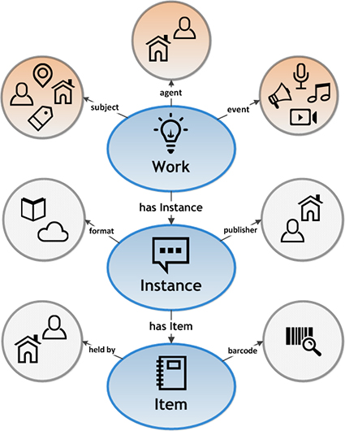
PCC Sinopia Templates and BIBFRAME
The primary PCC Sinopia templates each represent a single core level of the BIBFRAME model: a Work, an Instance, or an Item
_PCC BF2 Work (Monograph) = Work
_PCC BF2 Instance (Monograph) = Instance
_PCC BF2 Item (Monograph) = Item

Slide 4
Links between levels
Both an instance template and a work template are required to complete a PCC BIBCO description
Separate templates allow each level to act independently and be easily reused
Item description is currently optional
Work description
Only links from the Instance to the Work or to the Item are necessary (= dark blue arrow)
Sinopia automatically understands the inverse link (= dotted arrow)
Instance description
Item description

Slide 5
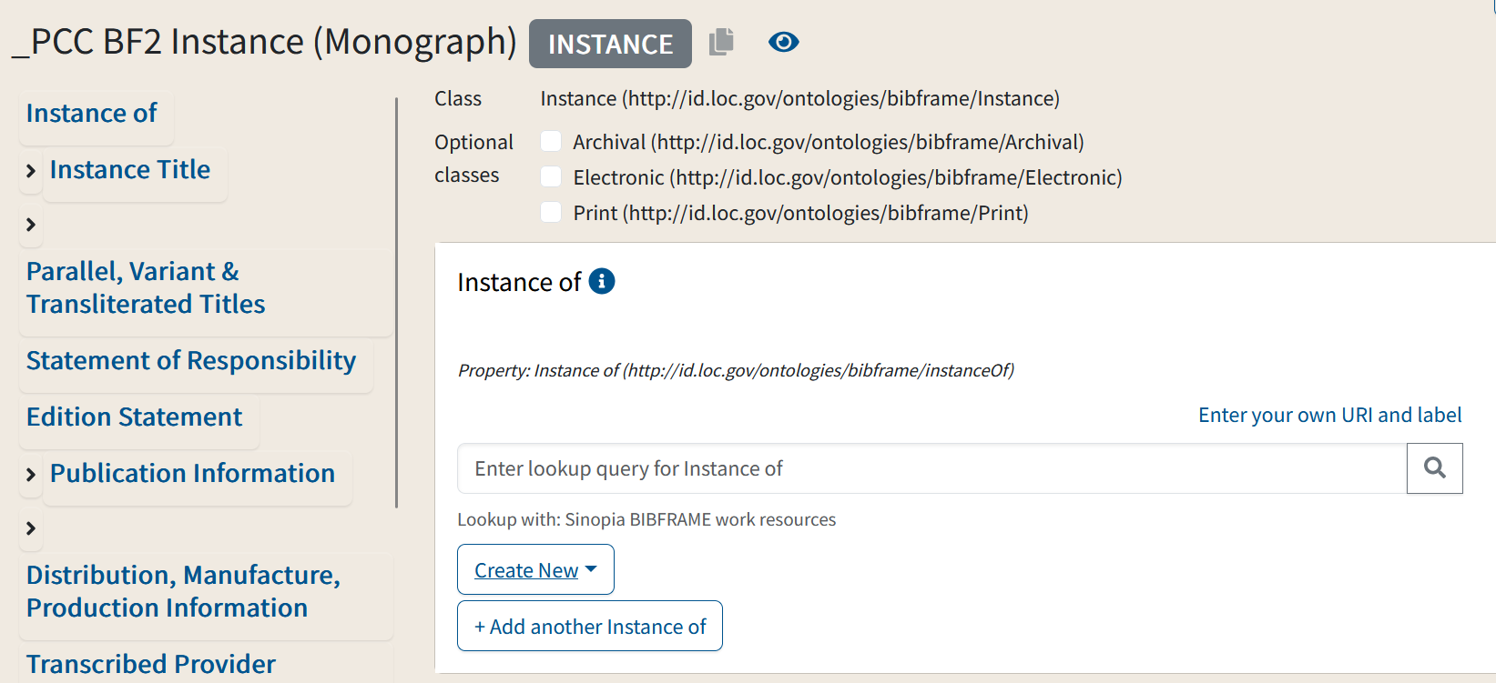
Linking the Instance to the Work
Work description
Instance description
_PCC BF2 Instance (Monograph) template
Use the "Instance of" field near the top of the template to link the Instance description to the Work description

Slide 6
Linking the Instance to Work
There are 3 options for linking to a work:
Do a lookup to a work that already exists in Sinopia
Create a new work and then do a lookup in Sinopia
Add a URI and label from another source

Slide 7
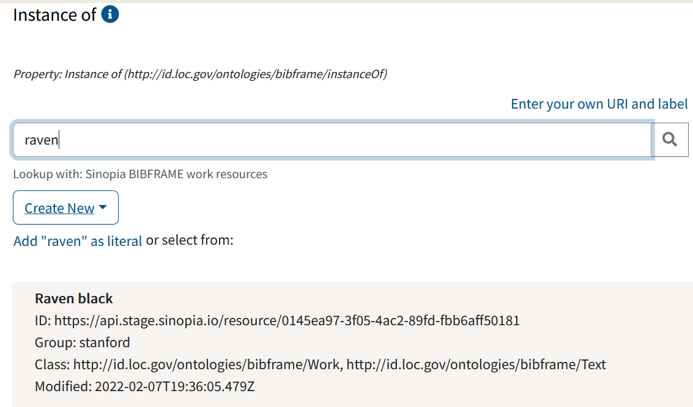
Do a Lookup in Sinopia for a pre-existing Work
Do this if:
You think there may be a work for your instance already in the database
You have already created a new work and want to link to it
How?
Simply do a keyword search for the title you want. Sinopia will search for BIBFRAME works.

Slide 8
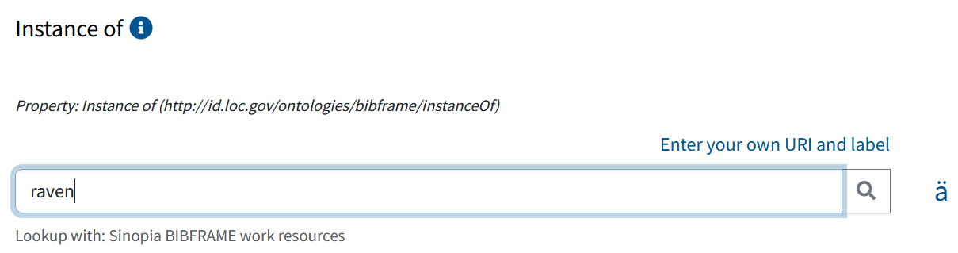
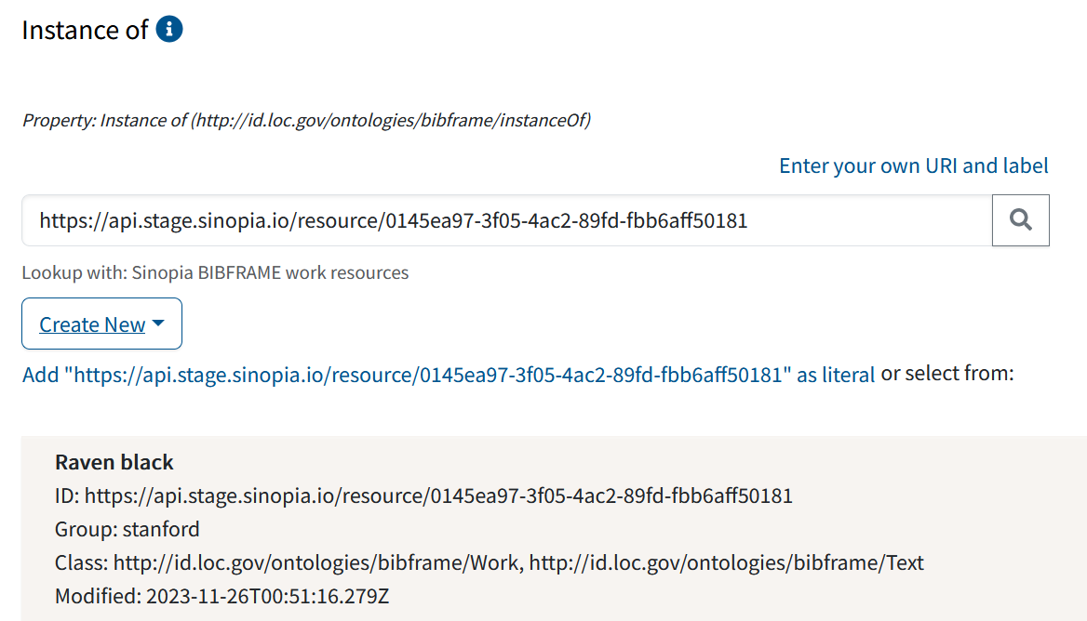
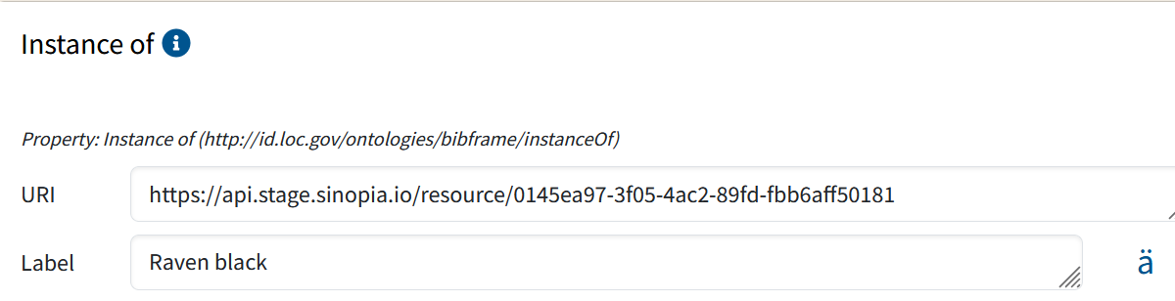
1.1 Do a Lookup in Sinopia for a pre-existing Work
Perform a keyword search
Click on the work description & enter
The URI and label will link to the Work from within your instance

Slide 9
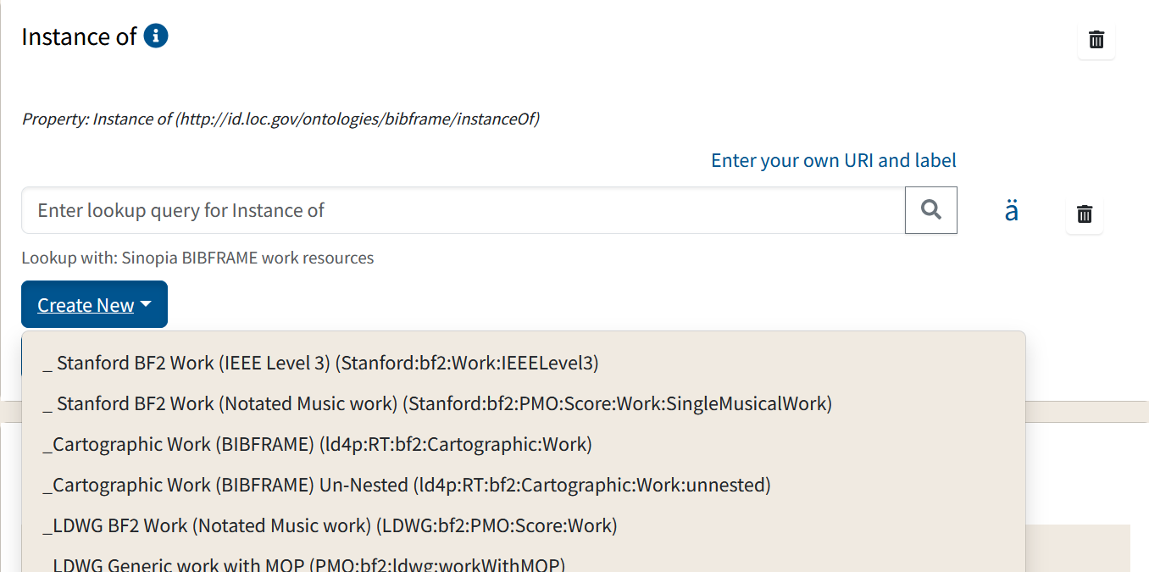
2. Create a New Work
Do this if:
You have searched Sinopia and know there is no available work description
How?
Click on the "Create New" button
Pick an appropriate template from the list of templates
Alternately, click on "Resource Templates" at the top of the page and select from your most recently used templates list

Slide 10
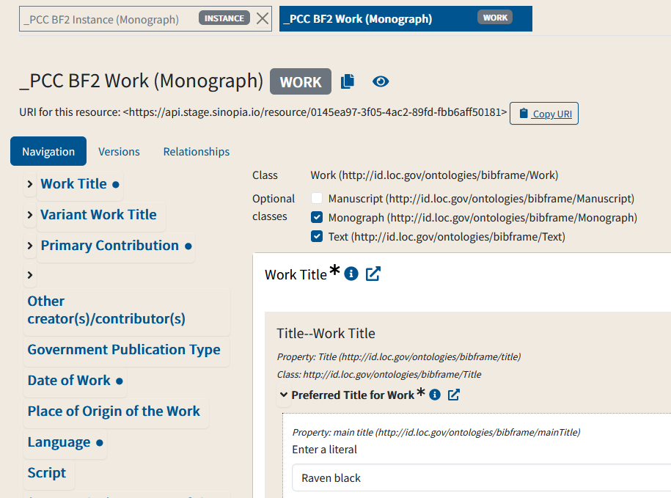
2.1 Create a New Work
A new work template will open with the Work title filled in based on the instance title
Edit Work title as necessary
Create your work description
Save the description
Copy the URI for your work
Return to your Instance description, paste in the copied URI, and do a lookup to the Work to link

Slide 11
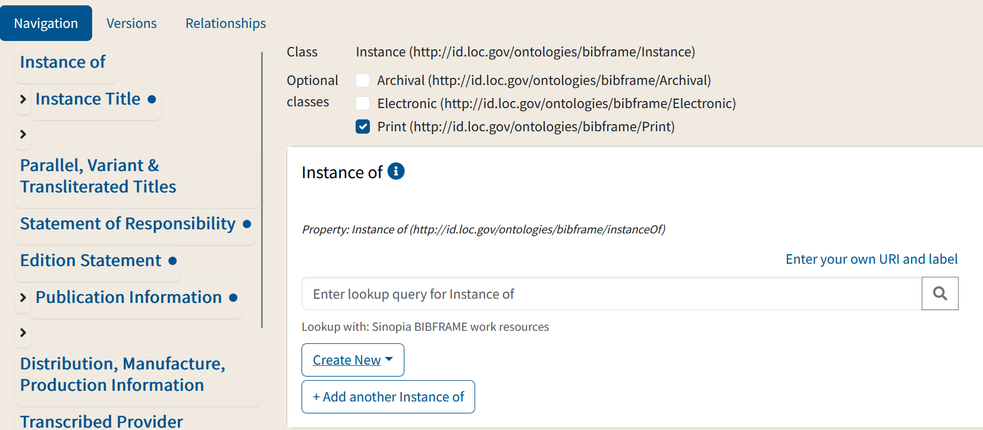
3. Manually add a URI & Label
Do this if:
You want to link to a Work description that is outside of Sinopia (e.g., SVDE)*
How?
Click on "Enter your own URI and label"

Slide 12
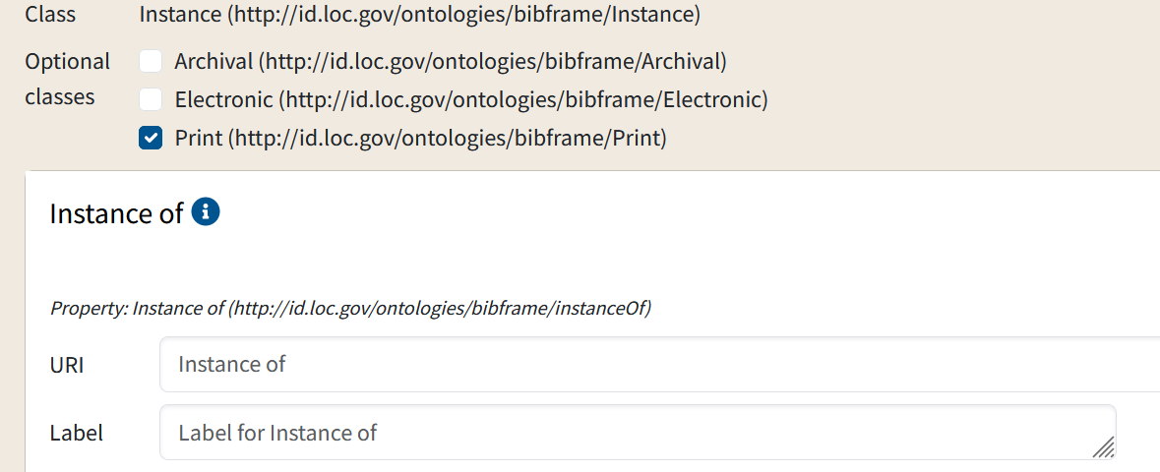
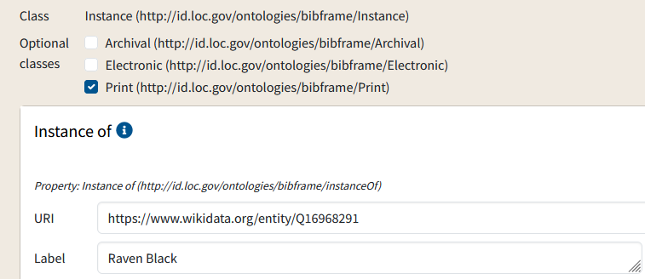
3.1 Manually add a URI & Label
The screen will change to allow for manual entry
Type in (or copy & paste) your URI and label. Make sure there are no extra spaces.

Slide 13
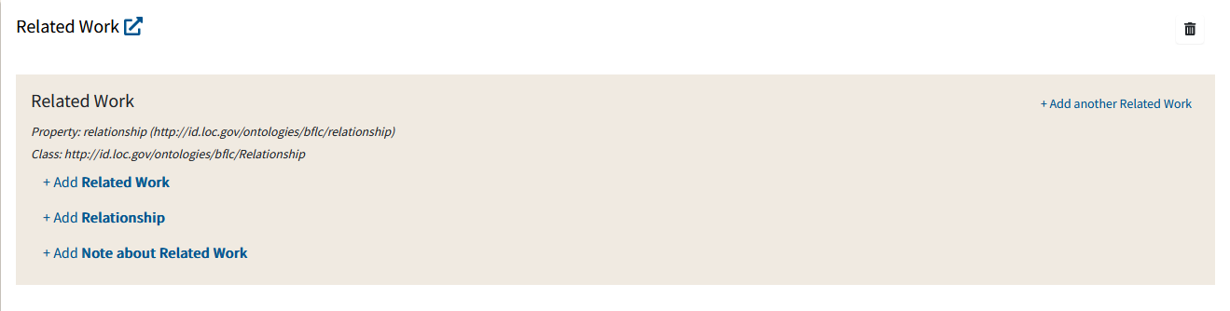
Related works
To link two related Works (for example, a novel and a film adaptation of the novel or an individual work within a compilation), use the Related Work field in a Work template.
This field includes a number of embedded subtemplates (see Module 4: About the PCC Templates for more information.) To add data you first need to click +Add Related work, and then +Add work (see next screen).

Slide 14
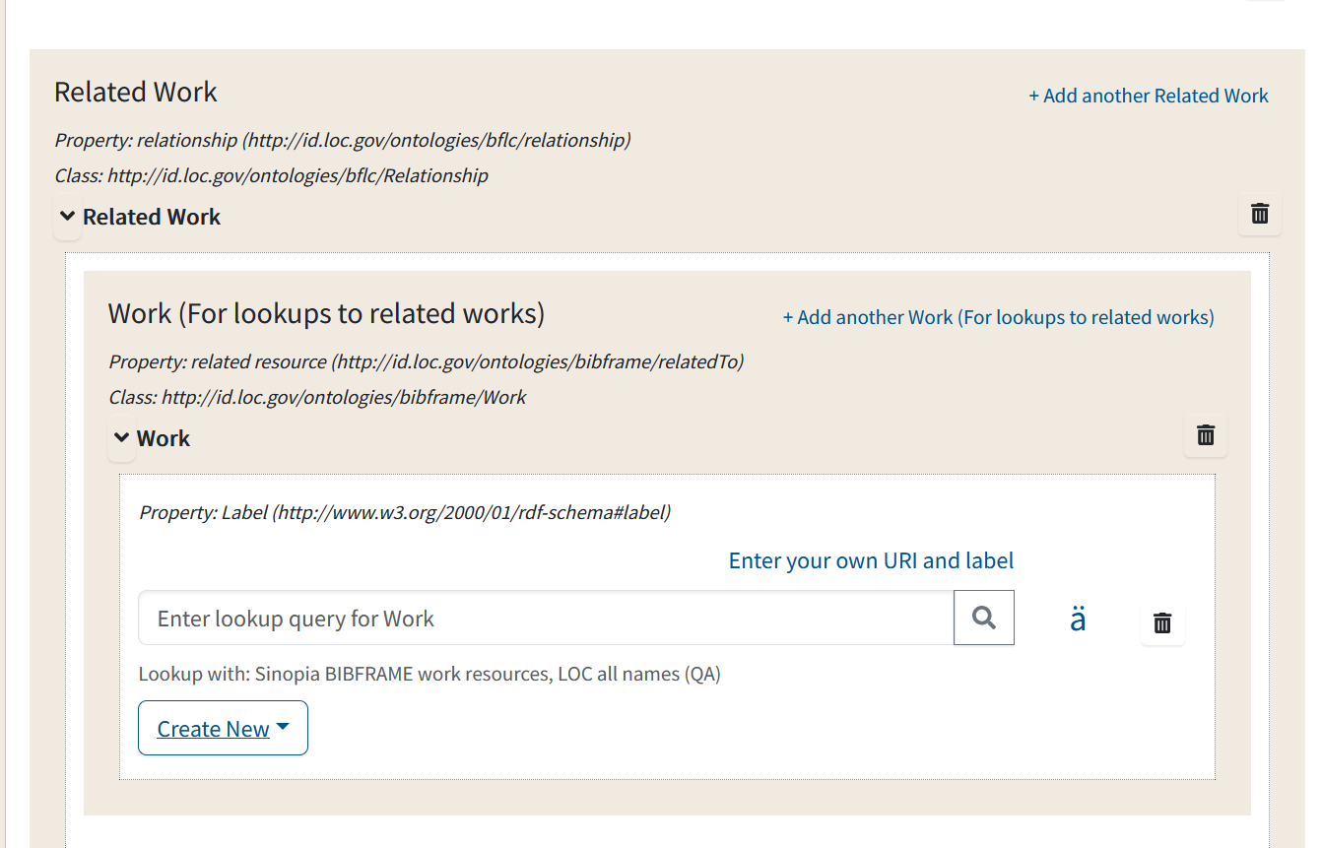
Adding a link to a Related Work
As when you link Works & Instances, you can link to a related work by:
Searching for the Work in Sinopia & linking to it
Creating a new Work & linking to it
or,
Manually adding an outside URI and label

Slide 15
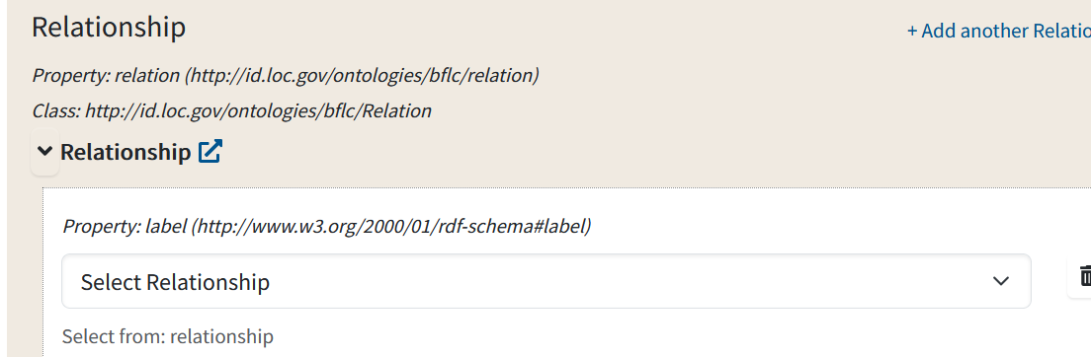
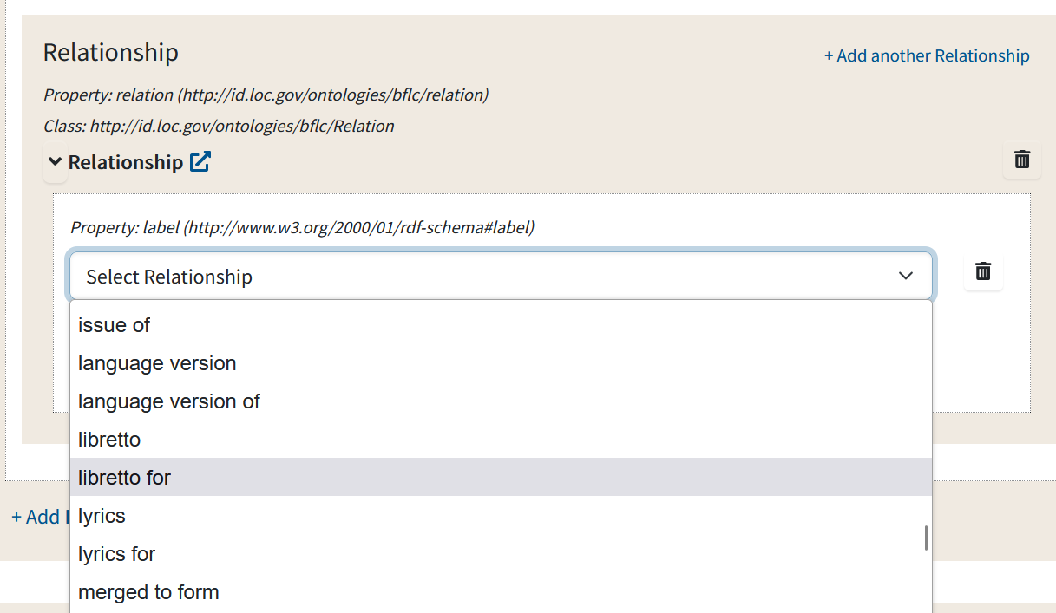
Adding a Work-to-Work Relationship Term
To add the type of relationship, open the Relationship field
Select the appropriate relationship from the dropdown menu

Slide 16
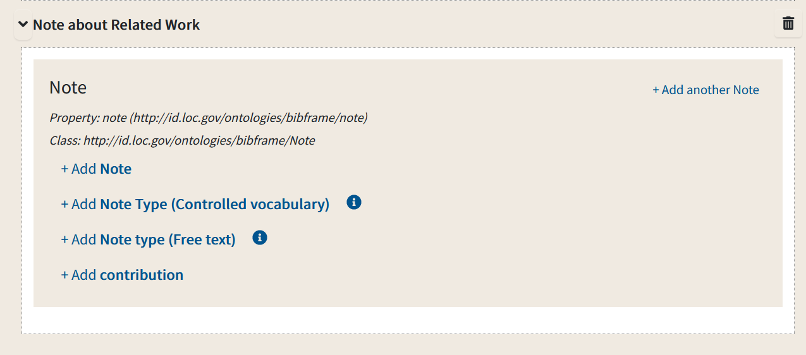
Adding a Related Work Note
If you feel the relationship term you picked needs further description, add a note

Slide 17
Related Work: inverse links
Work 1
Creating a link from Work 1 to Work 2 doesn't automatically create a link from Work 2 to Work 1.
If you want to create an inverse (reciprocal link), go to Work 2 and create a related work link back to Work 1, with the reciprocal relationship type.
Work 2

Slide 18
Linking more than one Instance to a Work
Work description
A Work might have more than one Instance, e.g., a print version and an electronic version of the same book. You can link both these instances to the same Work description; you don't need to create a new one. Likewise, an Instance may have more than one Item
This is why the Work & Instance templates are separate--so you can re-use descriptions!
Instance1 description
Instance2 description
Item1
Item2
* Officially, a BIBFRAME instance may also be linked to more than one Work. We are not yet using this in the PCC templates for technical reasons

Slide 19
End of Module 8

