Slide 1

Sinopia Module 9
Copying Descriptions

Slide 2
Scope of this module
Module 9: Copying Descriptions covers
why you might want to copy an existing description
how to copy an existing description in Sinopia

Slide 3
Why copy a description?
to re-use some of the metadata for a new entity that is very similar, e.g., copying a print instance to populate a newly added electronic instance of the same work
to save a description belonging to a group you are not a member of to a group you are a member of so that you can edit it

Slide 4

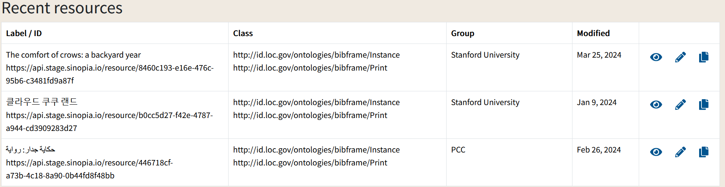
Copying a description--From Dashboard
To make a copy of a saved Sinopia description, use the “two sheets of paper” icon.
Search in Sinopia or results or select from the list under Dashboard / Recent Resources
Click on the "Copy" button

Slide 5
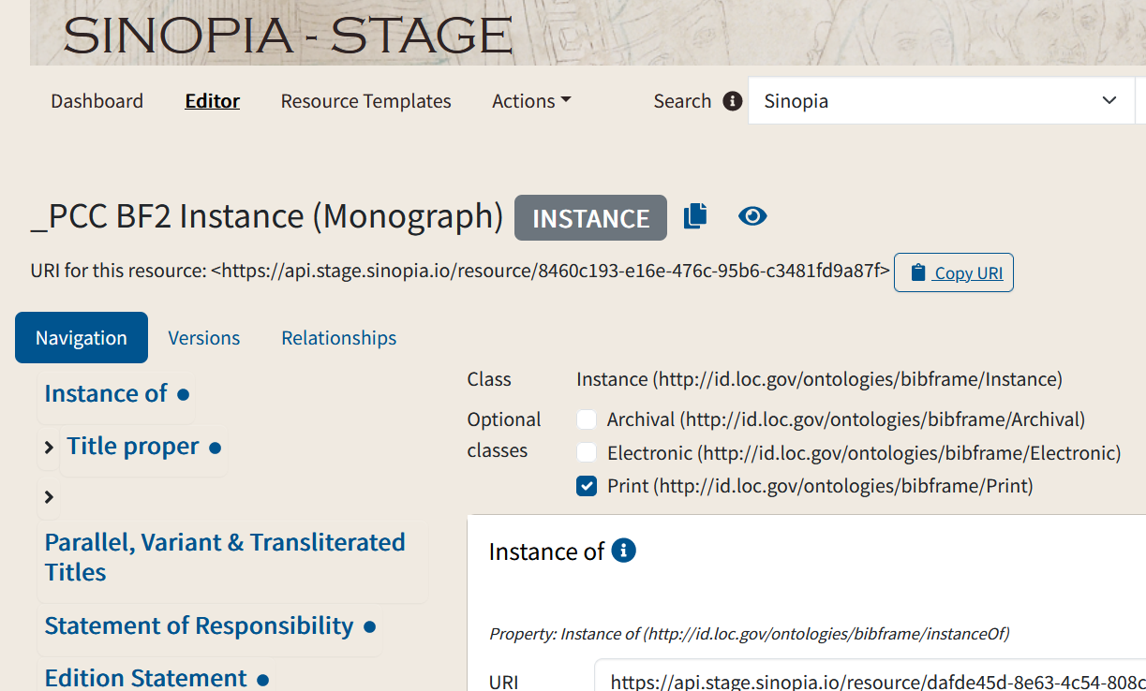
Copying a description--From Edit mode
To make a copy of a saved Sinopia description, use the “two sheets of paper” icon.
The copy button is also available when you are in edit mode for a single resource

Slide 6
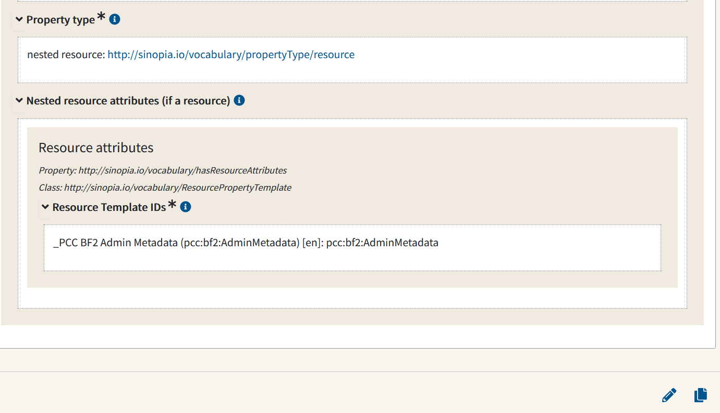
Copying a description – From Preview
To make a copy of a saved Sinopia description, use the “two sheets of paper” icon.
And finally, it is also available in Preview mode, at bottom of the screen.

Slide 7
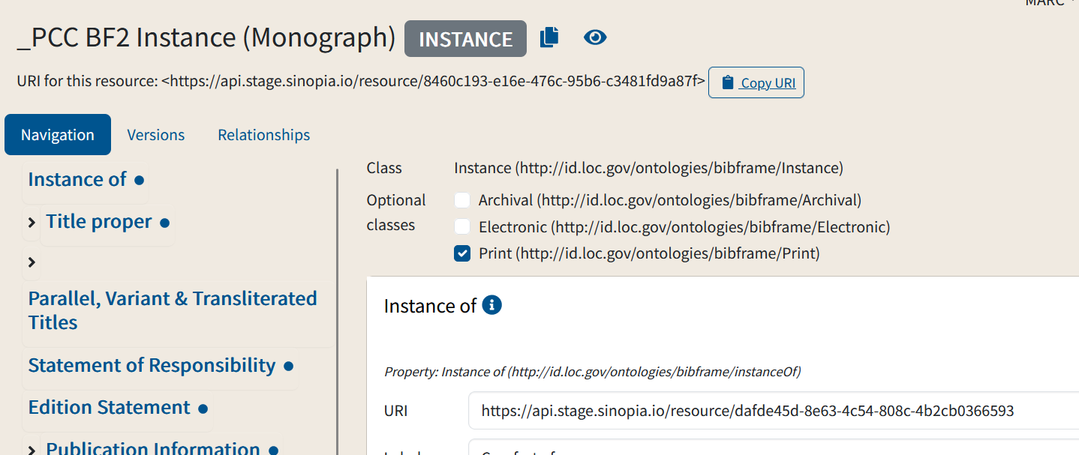
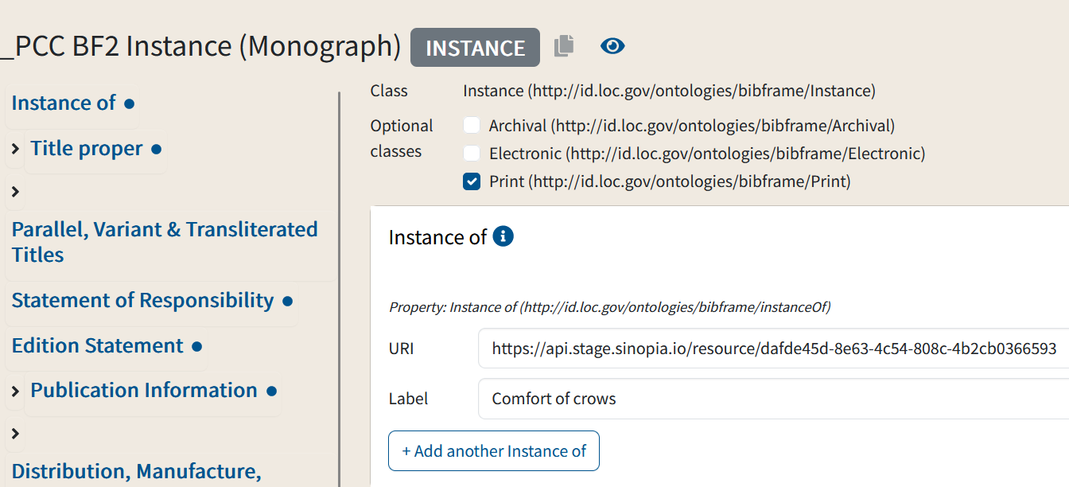
After you click Copy
When you click Copy, Sinopia opens a new tab under the Editor tab, containing an unsaved copy. Note that the URI for the original resource is no longer there.
You can now add and change data and save the new description.
A new, unique URI will be assigned when you save.
Original
Copy (before saving)

Slide 8
End of Module 9

